Slide 1

What do we know about homelessness in Wales and what works?
Dr. Peter Mackie
Cardiff University, UK
MackieP@cardiff.ac.uk

Slide 2
Overview
What happens if we do nothing? Core homelessness projections
Framing the evidence in relation to end goals
The evidence base: what do we know about homelessness in Wales and what works?

Slide 3
What happens if we do nothing?
Core homelessness projections

Slide 4
Drivers and risk factors
Poverty is the key driver
“The most important driver of homelessness in all its forms is poverty… Other drivers include, availability and affordability of accommodation, the extent to which prevention measures are used, and the demographics of people experiencing homelessness.” (Bramley, 2017)
Chances of experiencing homelessness by age 30 predicted by:
Childhood poverty (by far most powerful influence)
Geography (less likely in rural areas/lower housing market pressures)
Adverse experiences as teenager (school exclusion, drug use, care)
Early adult experiences (leaving education early, unemployment, renting, illness/disability, social relationships [with parents/partner/children])
(Bramley and Fitzpatrick, 2018)

Slide 5
Drivers and risk factors
Vignette 1: White male, with relatively affluent childhood in the rural area, graduated from university, living with his parents at age 26, with no partner and no children. Predicted probability of having experienced homelessness by age 30 = 0.6%.
Vignette 2: Mixed ethnicity female, experienced poverty as a child, brought up by a lone parent, left school or college at 16, had spells of unemployment, and living as a renter with no partner but with her own children at age 26. Predicted probability of having experienced homelessness by age 30 = 71.2%.
(Bramley and Fitzpatrick, 2018)

Slide 6
Core homelessness forecast, 2011-41
Great Britain
Wales
Source: Bramley (2017)

Slide 7
Framing the evidence in relation to end goals

Slide 8
Framing the evidence in relation to end goals
Prevent all forms of homelessness
Universal Prevention, Targeted Prevention, Crisis Prevention, Emergency Prevention, Recovery Prevention (Fitzpatrick et al, 2019)
End homelessness
No one homeless as a result of leaving a state institution
All at immediate risk of homelessness get the help needed to prevent it
No one in emergency accommodation without a plan for rapid rehousing
No one forced to live in transient/dangerous accommodation (tents/squats)
No one sleeping rough (Crisis, 2018)
Homelessness should be rare, brief and non-recurrent

Slide 9
Framing the evidence in relation to end goals
Rare, brief & non-recurrent | Homelessness ended | Homelessness prevented
Rare |  | Universal Prevention
 | No one homeless as a result of leaving a state institution All at likely risk of homelessness get the help needed to prevent it | Targeted Prevention
 | All at immediate risk of homelessness get the help needed to prevent it | Crisis Prevention
Brief | No one in emergency accommodation without a plan for rapid rehousing No one forced to live in transient/dangerous accommodation No one sleeping rough | Emergency Prevention
Non-recurrent | No one returns to homelessness | Recovery Prevention

Slide 10
The evidence base

Slide 11
Universal Prevention – What do we know?
Poverty is the key driver
“The most important driver of homelessness in all its forms is poverty… Other drivers include, availability and affordability of accommodation, the extent to which prevention measures are used, and the demographics of people experiencing homelessness.” (Bramley, 2017)

Slide 12
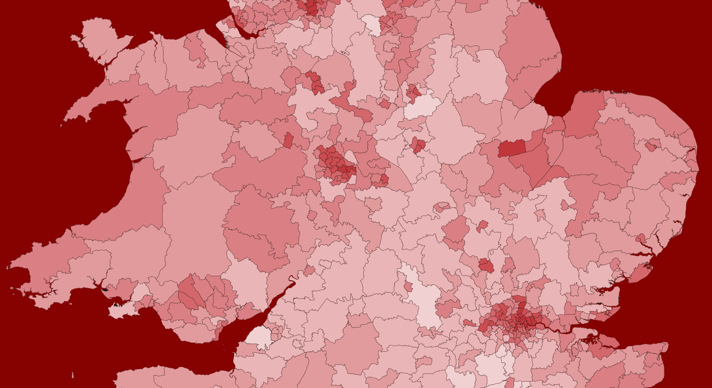
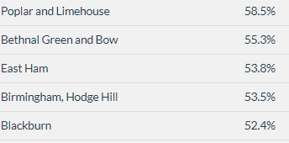
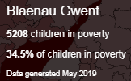
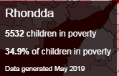
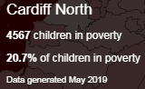
Child Poverty Levels, 2019
Source: End Child Poverty (2019)

Slide 13
Wales Local Housing Allowance shortfall 2018
Wales Broad Rental Market Areas (£)
Source: Crisis (2018)

Slide 14
Universal Prevention – What works?
Future policy scenarios and their impacts on core homelessness in GB
Source: Bramley (2017)
Notes:
Remember to mention Bevan work on Welsh benefits

Slide 15
Targeted Prevention – What do we know?
Leaving prison
In 16% of relief cases for single people - leaving prison is main reason
12% of people in the 2018 PIT count were released from custody into homelessness – the joint highest cause
Leaving care
In 3-4% of single person applications - leaving institution or care is main reason
During 2016-17, 677 young people aged 16 and over left care. 9% were in unsuitable accommodation at the date they left care (Stirling, 2018)
One third of care leavers (33 per cent) become homeless in the first two years after leaving care (Stirling, 2018)
24% of single homeless have been in local authority care (Mackie and Thomas, 2014)

Slide 16
Targeted Prevention – What do we know?
Leaving hospital
37% of people in the 2018 PIT count had ever been released from hospital into homelessness. 6% had been in the past 12 months.
Education
27% of single homeless have been excluded from school (Mackie & Thomas, 2014)

Slide 17
Targeted Prevention – What works?
Critical Time Interventions
Rapid access to housing and intensive case management
Case manager starts in the institution. At transition into the community there are three distinct phases
Widely adopted in the US and in parts of Europe. In Denmark the success rate for service users who ‘have been housed and maintained housing’ is 95%.
Sources: Crisis (2018) and Benjaminson (2013)

Slide 18
Targeted Prevention – What works?
Geelong/Upstream Project
Whole school screening, followed by youth and family support intervention
Developed in Australia. Resulted in 40% reduction in youth homelessness presentations
Source: Mackenzie (2018)

Slide 19
Targeted Prevention – What works?
Early (pre-crisis) identification and action on housing affordability issues
In parts of Europe (e.g. Amsterdam and Sweden) landlords are required to notify authorities when rent payment problems arise (European Commission, 2013)

Slide 20
Crisis Prevention – What do we know?
Statutory homelessness outcomes

Slide 21
Crisis Prevention – What do we know?
Statutory homelessness outcomes
Prevention (S66)
Relief (S73)
Final Duty (S75)

Slide 22
Crisis Prevention – What works?
The Welsh legislative duty
Is an effective tool
There is scope for more robust evaluation of what interventions are working with whom and why
There is also scope for further innovation
In Vienna landlords are required to notify authorities when an eviction procedure is initiated (European Commission, 2013)
Zero evictions into homelessness policies?
Crisis recommended that a new duty to prevent homelessness, and to cooperate with local housing authorities in relieving homelessness, should be extended to relevant public bodies (Crisis, 2018)

Slide 23
Emergency Prevention – What do we know?
Rough sleeping

Slide 24
Emergency Prevention – What do we know?
Households in Temporary Accommodation, Q3
Households in TA by duration, Q1 2017/18

Slide 25
Emergency Prevention
Source: Mackie and Thomas (2014)
Support needs are particularly high amongst single homeless people in Wales
The nature of support needs is changing (New Psychoactive Substances)

Slide 26
Recovery Prevention – What do we know?
At a national level we know very little about repeat homelessness
Some individual local authorities are exploring the issue
Some third sector service providers hold data on outcome sustainment

Slide 27
Emergency & Recovery Prevention – What works?
Source: Mackie et al (2017)
Housing-led solutions (e.g. Housing First and Rapid Rehousing)
Offer person-centred support and choice (e.g. Housing First, Personalised Budgets)
Take swift action (e.g. NSNO)
Employ assertive outreach leading to a suitable accommodation offer
Ensure services address wider support needs
Collaborate effectively between agencies and across sectors

Slide 28
Emergency & Recovery Prevention – What works?
Source: Adapted from Woods (2019)
Suitable and affordable accommodation must be available
Intervention programmes need appropriate, sufficient and consistent resourcing (inc. cross- departmental budgets)
Partnership working is paramount to programme success
‍Recruiting and training the right staff
Trauma-informed services and PIE

Slide 29
References
Benjaminsen, L. (2013) Sustainable ways of preventing homelessness: Results from the Housing First based Danish Homelessness Strategy and the challenges of youth homelessness. (Prepared for Peer Review in Social Protection and Social Inclusion programme)
Bramley, G. (2017) Homelessness projections: Core homelessness in Great Britain, Crisis: London
Bramley, G. & Fitzpatrick, S. (2018) Homelessness in the UK: who is most at risk?, Housing Studies, 33:1, 96-116
Crisis (2018) Everybody in: How to end homelessness in Great Britain, Crisis: London
End Child Poverty (2019) http://www.endchildpoverty.org.uk/poverty-in-your-area-2019/
European Commission (2013) Confronting Homelessness in The European Union, European Commission: Brussels
Fitzpatrick, S., Mackie, P.K. and Woods, J. (2019) Homelessness prevention in the UK: Policy Briefing, CaCHE: Glasgow.
Mackenzie, D. (2018) The Geelong Project: Interim Report 2016-17
Mackie, P.K. and Thomas, I. (2014) Nations Apart? Experiences of single homelessness across Great Britain, Crisis: London
SCIE (2018) A rapid evidence assessment of what works in homelessness services, SCIE: London
Stirling, T. (2018) Youth homelessness and care leavers: Mapping Interventions in Wales, WCPP: Cardiff
Woods, J. (2019) Five factors underpin good homelessness service implementation, Centre for Homelessness Impact: London

Slide 30
Thank you
Dr. Peter Mackie
Cardiff University
MackieP@cardiff.ac.uk

