Slide 1
Front door redesign
Discovery Report
Notes:
HMW questions/ opportunities, potential improvements
- Insights (around stages of journey?)
- Personas (goals, frustrations, behaviours and habits)/empathy maps and user journey maps that help showcase the needs of users and visualise their current processes. generalized profiles that outline the archetypes of your common users
- User groups and their needs, use cases
- Questions to prototype
- Business outcomes/ success factors
JOURNEY MAPPING
Basics: Stages, Goal(s), Emotional State, Pain Points (or Opportunities i.e HMW)
Additional: User Actions/ Activities, Logistics e.g Channel
Journey maps cover the path from discovery of a need/desire through to finding brands and products appropriate, to purchase. one, generic stakeholder perspective. Illuminate opportunities for improvement

Slide 2
Context

Slide 3
Background
Why the work is being done
The current 'front door' model for accessing the homelessness service could be improved to better the experience for both customers and staff. There is currently high demand for the triage appointments and the initial approach is currently managed by customer services who provide light touch advice but also deal with other service areas and queries in an open environment. There is potential to improve the joint working relationship between the two teams to improve the initial parts of a customer's journey through the service. There is also potential to engage partners to provide more support & advice rather than an approach to Rivers House being the ‘default’ route and better enable customers to support themselves with appropriate advice and information.
Problem to be solved
How might we redesign the 'approach' & 'triage/ advice' stages of the customer's journey to better meet the needs of customers and staff?
Who the users are and what they need to do
Users are anyone approaching the service through any channel - both those with a need for accommodation or assistance in obtaining accommodation (triggering a homelessness application) and those that do not meet this threshold
Any work that’s already been done

Slide 4









Existing Process
EXAMPLE
‘Mappers’ ‘vulnerable lettings’ for offenders who are restricted on where allowed to live - not discharged by homeless team
X2 triage
X1 appointments
X2 back office to catch up
X1 admin + 3 weeks
Admin now undertake compass applications to aleviate pressure on options officers
s.179
s.188
s.184
s.184
s.184
s.189A
Aware
Approach
Triage & Advice
Interview Preparation
Interview
Personal Housing Plan
take basic details
make enquiries
internal referral
process referral
assess urgency
online advice
advice from online web pages
phone enquiry
request evidence
f2f
confirm appointments
process referral
>
process calls
>
>
>
external referral
phone
full assessment of circumstances and needs
create plan
initial options and advice
F2F
verify evidence
F2F
agree plan
signposted to service by person, organisation or IAG
process emails
log case on jigsaw
issue outcome
issue plan
signpost
email
...
deal with urgent issues
process post
f2f advice
initial assessment
existing knowledge of service
...
book interview appointment
self
post
refer and/ or close case
s.202
issue decision
s.202
>
initial options and advice
log case on jigsaw
deal with urgent issues
phone advice
initial assessment
Exit customer journey
book interview appointment
refer and/ or close case
written advice
...
>
outcomes/ consequences
actions
Exit customer journey

Slide 5




Approach & methodology: user-centred design and agile
Phases (iterative)
  Discovery
  Ideation
  Prototyping
  Implementation
Research to explore and better understand the problem. Build empathy and understanding of users, their needs and aspirations. Seek inspiration from others. Synthesise research into meaningful and actionable insights, identifying opportunities for design and improvement.
Brainstorm solutions to opportunities identified. Identify whether to re-use existing practice ideas or develop something new. Select most promising ideas and develop into concepts to take forward
Develop rough and working prototypes of selected concepts. Share and get feedback early to test hypotheses, assumptions, risks and key elements of the idea. Integrate feedback and keep iterating. Define a 'minimum viable solution' that meets key user needs
Develop roadmap for full solution. Continuous improvement after 'go live' - can include full pilots. Deliver more user needs identified in earlier phases and adapt to changing needs. Measure and monitor against KPIs
Description
Business case or benefits case
User research report (qualitative, ethnography)
Secondary research
User Journey and/ or Experience Maps
Service Blueprints
Insights & Design Opportunities
Tools/ Outputs
Show and tell
Brainstorming
Idea ranking
Storyboarding
Create a concept
Prototypes (low-res to high-res and live)
Minimum viable products/ solutions
Experience prototyping
Storyboarding
Feedback capture grids
Scenarios & Use Cases
Roadmap and KPI report
Implementation plan
Toolkit & outputs for others to adopt
Tested assumptions with real users and iterated designs accordingly before committing further resources
Identified biggest risks and reduced this
Identified what's most important
Product/ service that works for users and meets prioritised needs
Started measuring the performance
Shared understanding of problem
Frame design opportunities
Understand user types and needs
Understand user experience today
Identified solutions
Key concepts to take forward to next phase
Outcomes

Slide 6
Discovery plan
Discovery Goals
Establish detailed understanding of how front door to service currently works
Put together detailed picture of experience staff have working in front door and service users have engaging with council through front door
Pick out key insights such as specific parts of the process that don't work very well, specific opportunities for change
Put together picture of the user journey, including when they become aware of the service before they have approached
Get a detailed understanding of the types of people that use the front door and the types of problem they have
What we already know
Assumptions
What do we need to learn more about/ what don't we know

Slide 7
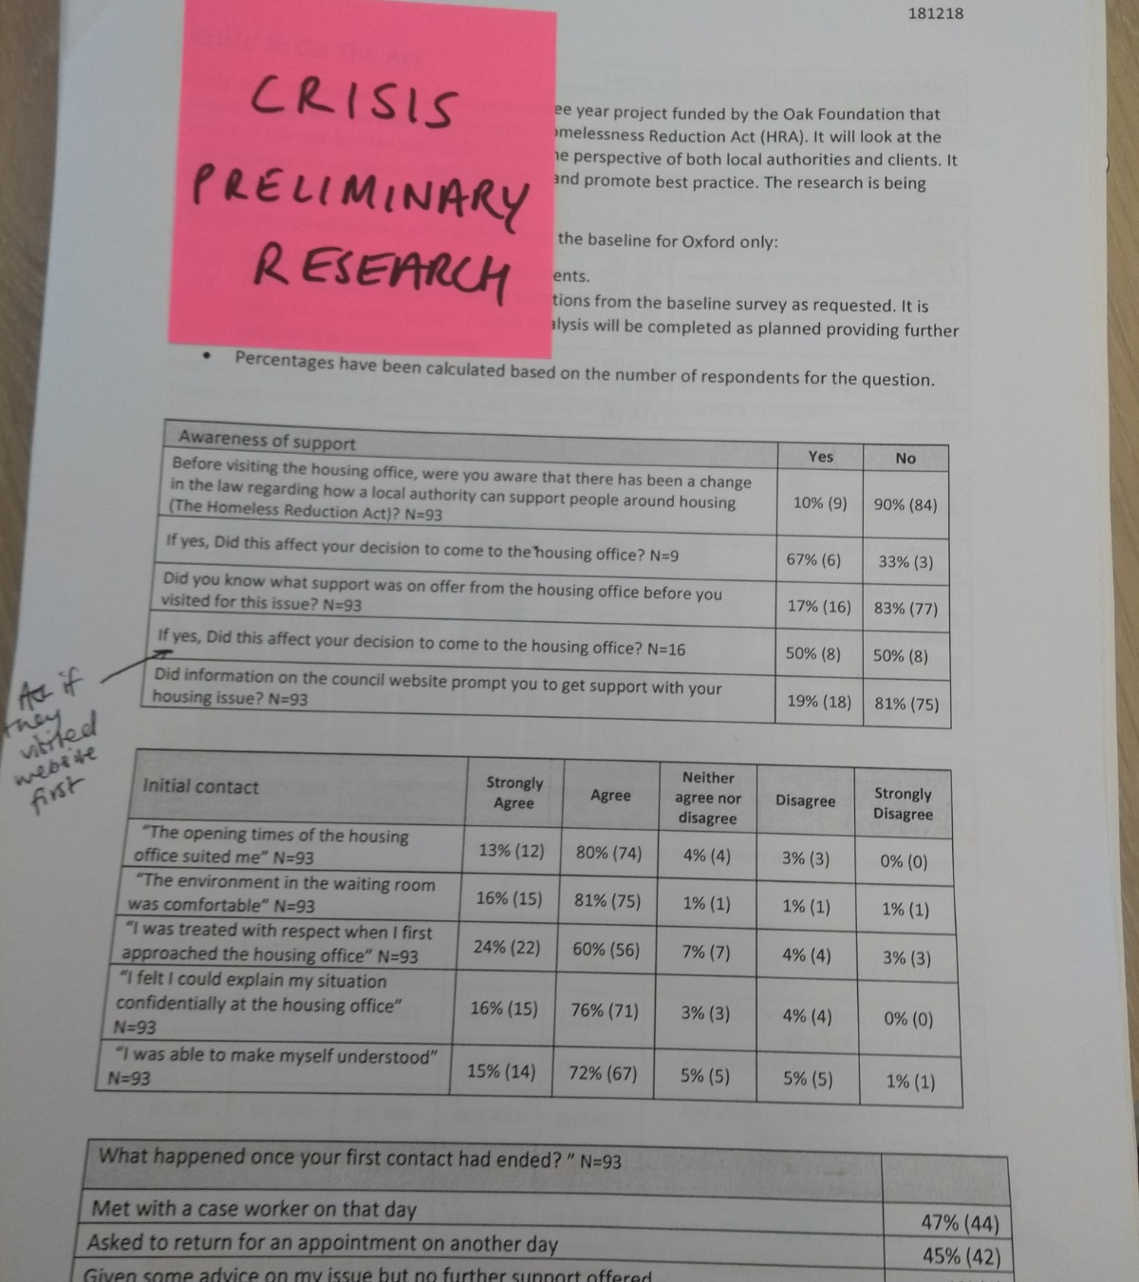
Our research
Customer survey with x responses
Survey with members of the homelessness forum - x responses including follow up presentation and discussion
X staff workshops with representatives from various internal teams inc. customer services and the homelessness service (x staff attended in total)
Data analysis (equality, contact and H-CLIC data)
Desktop best practice research

Slide 8
User groups
Who we are designing for
Notes:
- Personas (goals, frustrations, behaviours and habits)/empathy maps and user journey maps that help showcase the needs of users and visualise their current processes. generalized profiles that outline the archetypes of your common users

Slide 9
Customer
Customer Service Officer
Homelessness Officer
Advocate
Internal Team Officer (Middlesbrough)
Internal Team Officer (13)
Partner agency officer
Initial user groups identified
Notes:
Goals/ Frustrations/ Behaviours and Habits

Slide 10
User groupings from research
Notes:
persona spectrums focus our attention on a range of customer motivations, contexts, abilities, and circumstances. By designing along a spectrum of need and motivation, we avoid the biases and assumptions built into a persona. physical, social, economic, temporal, cultural contexts
Physical context
Situational context

Slide 11
Key insights
Notes:
What happens now? - Pain Points, Opportunities

Slide 12
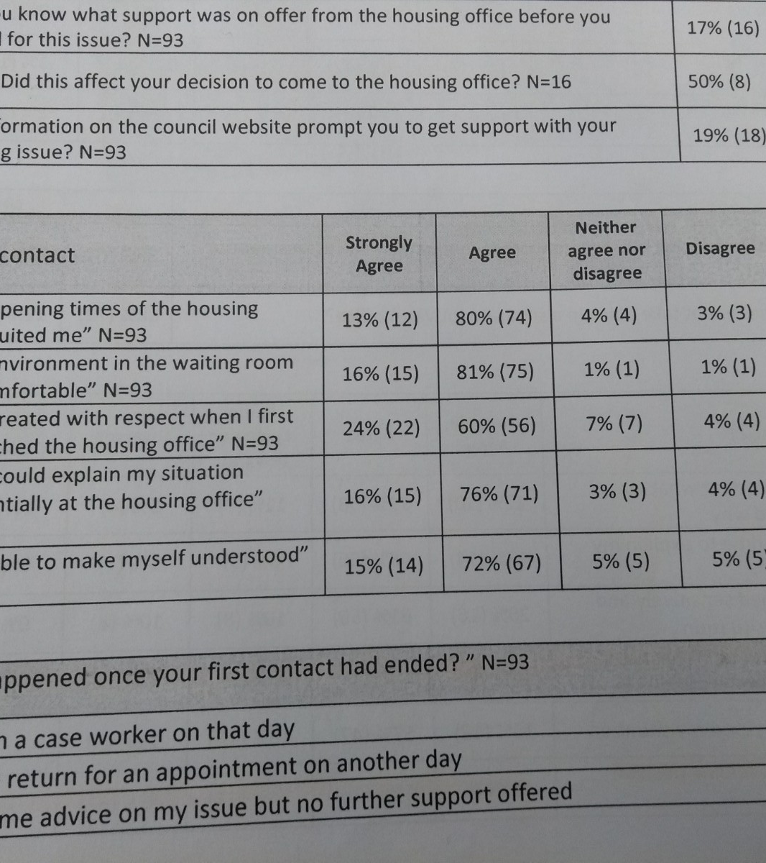
Service Users
Notes:
Around needs/goals/pain points

Slide 13
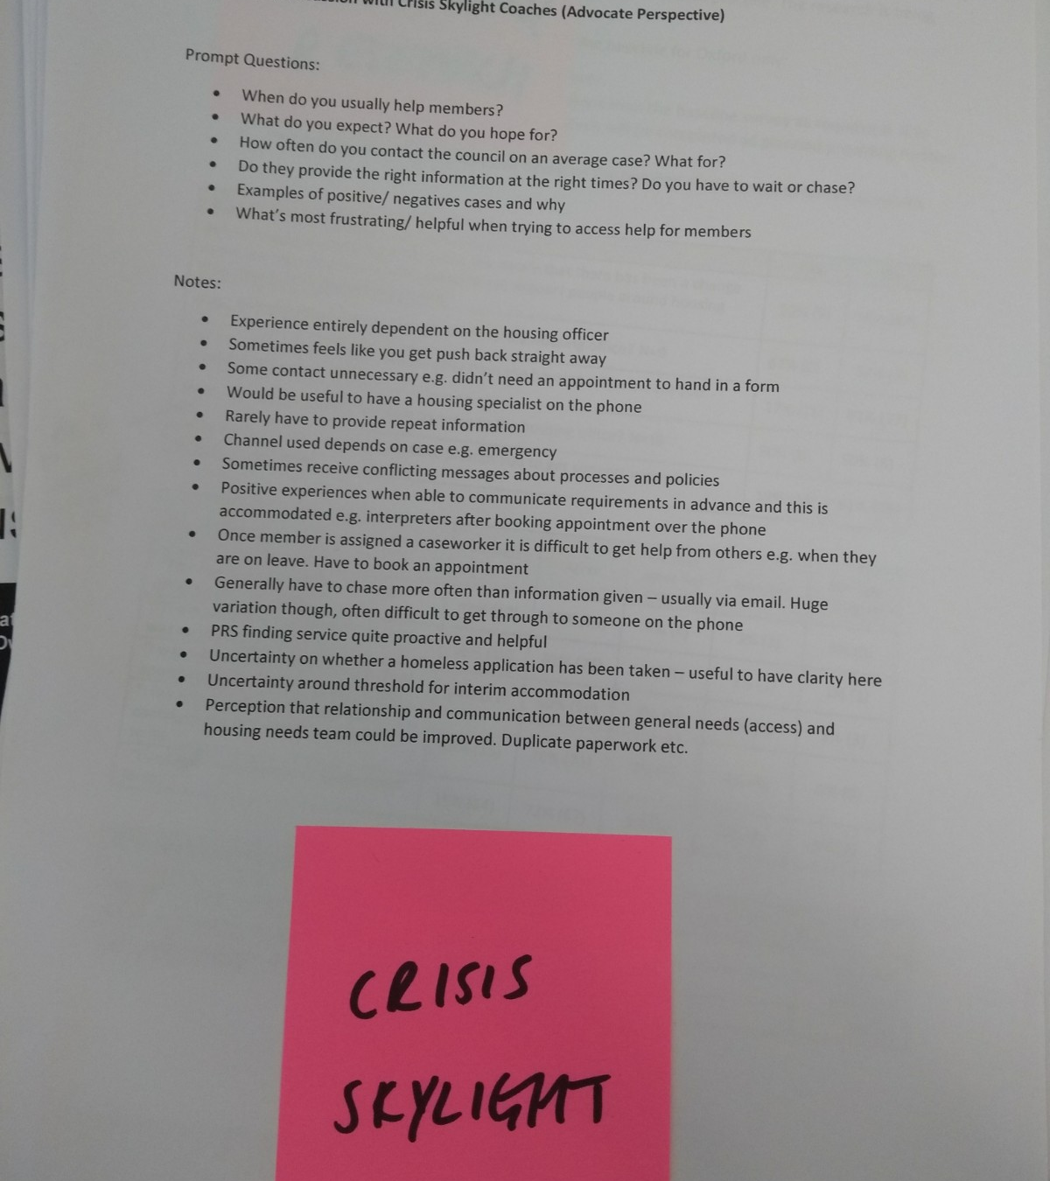
Local Partners
Notes:
Around needs/goals/pain points

Slide 14
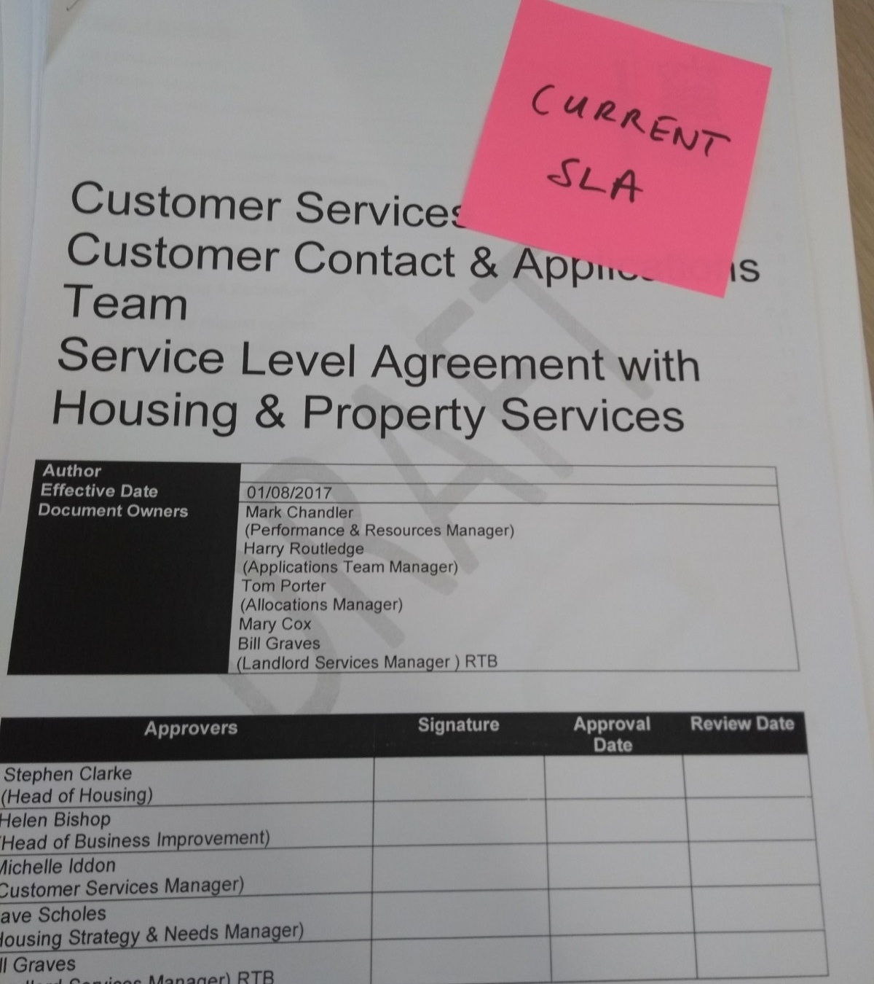
Customer Service Officers

Slide 15
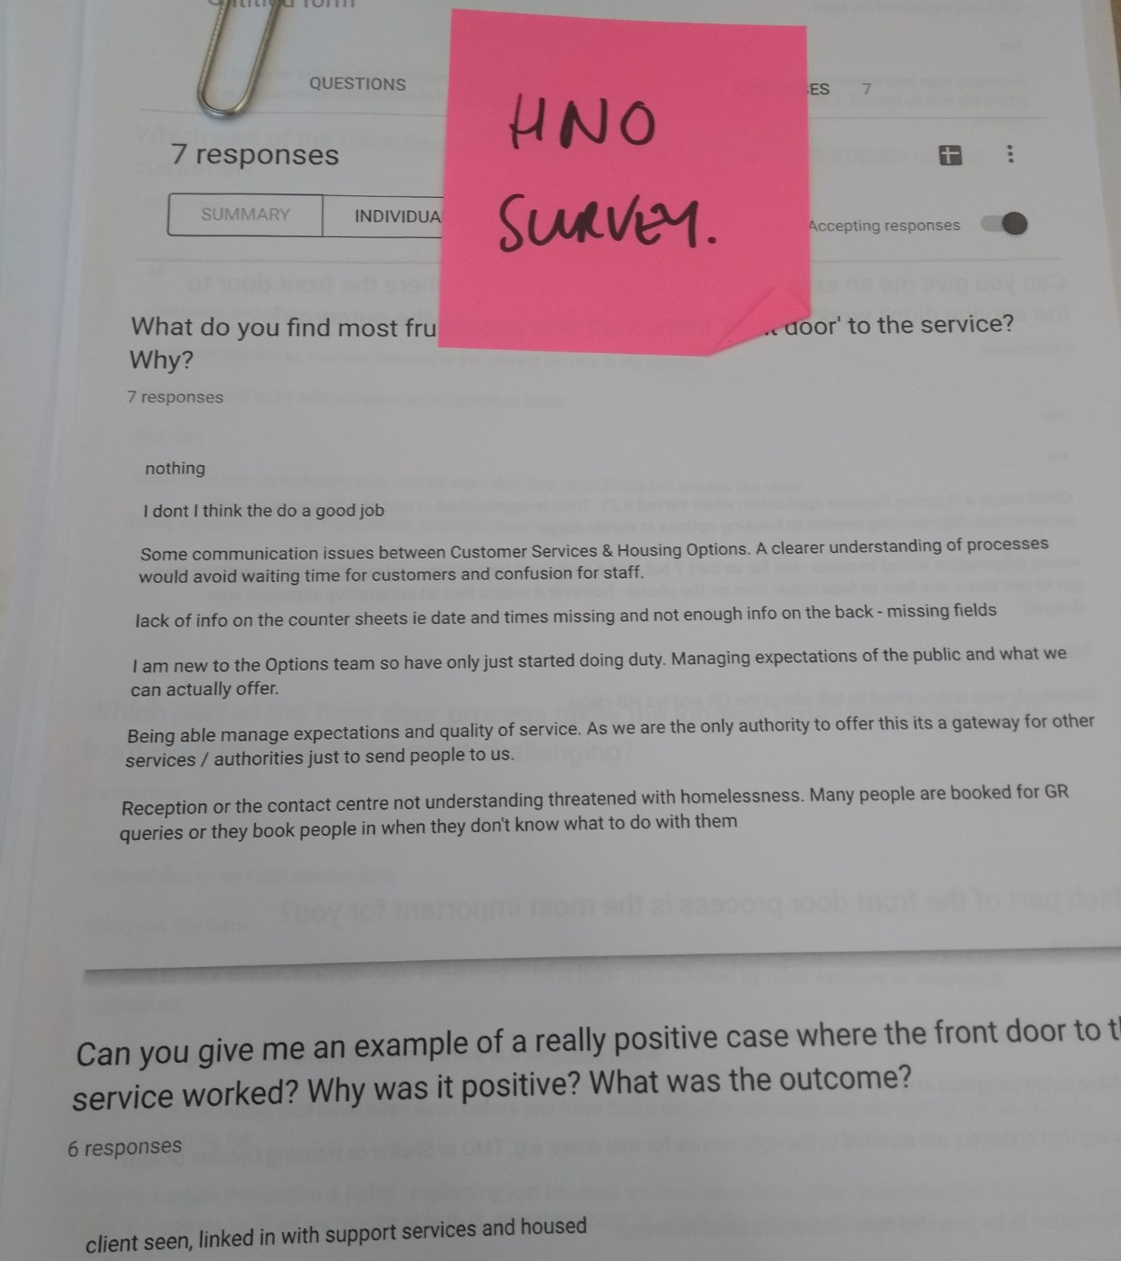
Internal Teams

Slide 16
Homelessness Officers

Slide 17
Example practice from elsewhere
Some local authorities have 3rd sector agencies co-located within the housing options service (e.g. Solace and Shelter with LB Southwark) or other statutory services like JCP
Service navigators help reimagine the homelessness sector from the service user's perspective and give them more control over what support they receive. This can include specific 'navigator' roles embedded within the community and other areas but also high quality information, advice and guidance to support people to access services. This can often include service directories, resource packs or a map of local services and how each can assist someone. Increasingly, local authorities are looking at how digital solutions can support this as well.
Early identification of those at risk of homelessness. Uses council data and predictive analytics to identify households most at risk of entering homelessness. Enables local authorities to contact those identified sensitively and target earlier intervention and prevention as well as monitor the efficacy of the interventions made e.g. online self-help or referrals to community support
Luton are designing an online self-help tool on the council’s website to help direct people with higher levels of resilience/capability to self-serve. They have prototyped an early version of what the self-help might contain (for example raising awareness of risk of financial or housing insecurity, a budget calculator, actions and tips to prevent homelessness) and now want to develop it. This will also include a "support checker" to help residents understand the severity of their situation and direct them to the type of support they need. They have been prototyping different kinds of questions and phrasing that would resonate with customers as a user needs to become aware of their own risk (as many people would not identify with the term ‘homeless’)
Local authorities are using various methods to increase access to advice and assistance and widen the reach of the service from single physical locations. Methods include home visits, 'floating' mobile advice or outreach surgeries and options officers co-located in partner organisations advising on early signs of homelessness. The purpose is to improve accessibility and resolve housing problems before they become a tangible threat of homelessness
Motivational interviewing skills and training, including trauma informed and strength-based approaches
Pre-interview packs and information provided to customers
Publishing service standards detailing what service users can expect - these should be co-produced with service users, monitored by local authorities and audited. Need to be user-friendly and time based

Slide 18
User Needs
(At each stage of the user's journey)
Notes:
Prioritised list
Are we meeting now
Most important, evidence-based, focus on the problem

Slide 19
Aware
Notes:
Advice and information
Who/What/Why [Goal]
I need/want/expect . . .

Slide 20
Initial Approach & Triage
Notes:
My rights
Reasons for information and questions that will be asked
What the council can do to help me
Chance to explain my situation
Knowledgable staff member

Slide 21
Appointment

Slide 22
Outstanding questions

Slide 23
What we don't know

Slide 24
Improvements & opportunities
Notes:
Hypothetical concepts, features, journeys
MVP
Scope of solutions

Slide 25
Short term improvements
Notes:
Prioritise to prototype

Slide 26
Design Opportunities
Notes:
Prioritise to prototype
How might we expand/ extend the reach of the housing options service and improve service accessibility? e.g. outreach, advertise services widely including other related support services, other services providing housing advice (link with trailblazer)
How might we develop a comprehensive IAG offer that meets the enhanced advisory duty? How might we monitor this to ensure it meets the needs of all sections of the community?
How might we increase awareness of support services available and facilitate self-help where appropriate? e.g. resource pack about local organisations and services (map with descriptions)
How might we develop options for users to input into front door design and delivery?
How might we proactively identify those at risk of homelessness and provide early support that prevents approaches to the service? E.g. predictive analytics
How might we utilise digital technologies in the front door and enable customers to do more through digital channels?
How might we better manage client expectations during their journey? e.g. a code of standards for the options service/ front door - “This is what you can expect from me, this is what I expect from you”, what can/ cannot be done, what the service needs

Slide 27
Business Outcomes

Slide 28
Measures of success
Define metrics
Awareness of support
Accessibility of service
Quality of advice
Appropriate outcome of initial contacts inc. signposting and referrals to correct agencies
Management of expectations
Website performance
Customer feedback/ experience
Missed appointments

Slide 29
Current performance

Slide 30
Plan & next steps
Notes:
Product roadmap

Slide 31
Delivery Plan
EXAMPLE
This plan represents our intentions, not a commitment. It will be regularly updated and changed. High-level objectives and delivery dates are shown for 3-month project increments
2019 |  |  |  |  |  |  | 2020
Jun | Jul | Aug | Sep | Oct | Nov | Dec | Jan | Feb | Mar
Reiterate purpose of the PHPs and value to officers and customers
Structure and clarity around PHPs
Set up customer feedback
Use customer feedback
Improving the PHP and assessment process for officers; which will lead to more consistent and better quality plans for our customers
Make best use of existing supporting tools to help officers
Framework for performance and support
Awareness and use of existing tools
Develop and enhance existing tools
Develop a prevention & relief toolkit to support officers
Develop toolkit MVP (for new starters)
Toolkit iteration (TBC)
Toolkit iteration (TBC)
Notes:
Schedule of timeboxes (2-4 weeks). Who/What/When. Demonstrable outcome/objectives/deliverables - "backlog"
Delivery plan. 6 weeks
High objectives and delivery dates for future increments
Long term vision: ultimately achieve for users. value of project. Project increments (with clear objectives/goal). Measure progress.
This roadmap represents our intentions, not a commitment. It will be regularly updated and changed.
Firebreaks

Slide 32
Work Plan (June 2019)
EXAMPLE
Work Item | Description | Deliverables | Lead Resource
Structure and clarity around PHPs
Interview Script | A short script for officers to refer to and use at the start of each assessment interview. Will communicate client rights, the process and what they can expect | Draft script | Andrew/ Laura
Case Review Sessions | Incorporate role and quality of PHPs into new case review sessions. Interactive discussions to clarify purpose with practical examples | Case review sessions started Key messages to relay | TBC
Set up customer feedback
Customer Survey | Draft and review survey to start collecting customer feedback | Draft survey Draft approach | Joe
Framework for performance and support
Competency Framework | Include staff confidence and performance with assessments/PHP in competency framework (in development). Could include self-assessment element | Proposal for how to include within competency framework | Michelle
Peer shadowing and support | Discuss with staff at next peer support groups how they want to utilise peer support to improve PHP consistency and quality. One idea we had was peer shadowing & feedback | Discussion at peer support session Officer ideas to take forward | Michael
Awareness and use of existing tools
Interactive List | Provide interactive list of current tools available with embedded links and brief description | Draft list | Joe
Supporting activity
Baseline to measure progress | Use case file audit to provide a baseline to measure progress against and success of this project | First round of case file audits complete | John
Validate user needs | Review the user needs drafted with officers to validate and amend as necessary | Validated user needs | Michael/ Andrew
Project resource/ capacity (June)
Name | Days
Joe | 3
Michelle
Michael
Charlotte
Laura
Andrew
John | On request
Notes:
Schedule of timeboxes (2-4 weeks). Who (resources)/What/When. Demonstrable outcome/objectives/deliverables - "backlog"
Measure progress – completion of products or other deliverables
Initial MosCoW prioritisation – requirements
Objectives/ Requirements/ Deliverables/ Tasks
Work Item – Priority – Description – Acceptance Criteria – Lead Resource

