Slide 1
Time & Motion Exercise Results Template
<Date>

Slide 2
Exercise Completion
x officers (x%) completed the exercise:
  X completed it as advised, identifying 1 activity per 30 minute time slot
  X identified multiple activities per 30 minute time slot
Y officers (y%) completed the exercise:
  Y completed it as advised, identifying 1 activity per 30 minute time slot
  Y identified multiple activities per 30 minute time slot
A couple of staff submitted two completed weeks
The majority were completed for week commencing <date>
Results will be presented separately based on the way the officers completed the activity

Slide 3
Activities and definitions

Slide 4
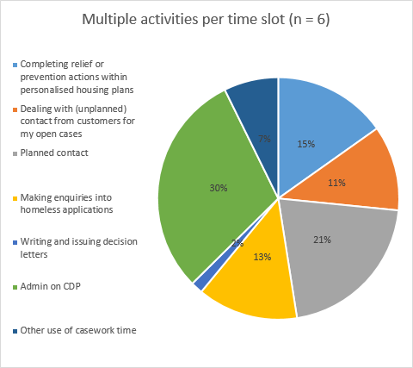
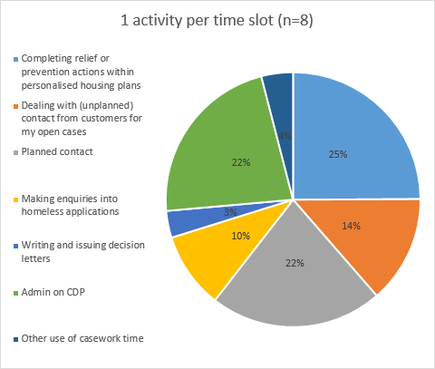
Example Summary

Slide 5
Themes
EXAMPLE
Assume average casework time of 2 days per week, broken down into the following . . .
Add themes
Activity | Median Position | Range
Admin on <case management system> | 1st | 22% – 30%
Planned contact | 2nd | 19% - 22%
Completing relief or prevention actions in PHPs | 2nd | 15% - 26%
Making enquiries into homeless applications | 4th | 10% - 18%
Dealing with unplanned contact | 5th | 10% - 14%
Other use of casework time | 6th | 4% - 7%
Writing and issuing decision letters | 7th | 2% - 4%

