Slide 1
Workshop facilitation guide
Prevention & Relief Toolkit
Notes:
partly on finance and funding
where you think councils are in terms of preventing homelessness one year in to the HRA duties
How is the HRA being implemented one year in, what are the biggest challenges for the future as you see them
welfare, LHA rates and universal credit, and it would be great if you could talk about that. One of the big questions that we want to get to is just how much this work actually costs local authorities

Slide 2
Rough plan for 90 mins – feel free to adapt
Timing | Exercise | Intent | Inputs | Outputs
5 mins | Introductions & purpose of workshop | Introduce the work, purpose of the workshop, value of their input etc. | - Challenge brief
40 mins | Group interview/ discussion | In-depth conversations to understand and empathise with officers | - Discussion guide - Template to capture notes | - Interview notes - Direct quotes
40 mins | Journey mapping | Build common understanding of consistencies/ differences between officers and identify pain points/ opportunities in the current process | - Props for journey mapping | - Journey maps
5 mins | Wrap up | Summarise next steps
crisis.org.uk

Slide 3
Purpose of workshops
Give officers first opportunity to input into process
Confirm challenges around consistency and quality of personalised plans
Understand how officers do things at the moment
Start capturing requirements and what officers need from a toolkit
crisis.org.uk

Slide 4
Group Interview/ Discussion

Slide 5
Group Interview/ Discussion Approach
Have one person facilitating and one person writing notes
Your role for this workshop is user researchers so try to be objective and avoid bringing in your personal thoughts, feelings etc.
Try to give everyone an opportunity to speak
Capture important quotes directly
Use the guide as a prompt but ask questions openly and probe with follow-up questions where necessary
Think about the best way to capture notes so it easier to write them up after
Please put everything in the sharepoint folder
crisis.org.uk

Slide 6
Group Interview Discussion Guide
Can you describe how you currently approach completing assessments and personalised plans for customers? What tools or resources do you use (if any)?
Do you see the value of the assessment and plan? Do you think they've improved things since the HRA came in?
Do you feel confident during the process? Do you have the resources and knowledge to complete the assessment and plan effectively?
Is it clear what is expected of you? Please explain your answer
What do you find most frustrating (if anything) about the process?
Would you value a toolkit to help with assessments and personalised plans? If yes, what would you find most useful in a toolkit?
crisis.org.uk

Slide 7
Interview Notes – Question 1

Slide 8
Interview Notes – Question 2

Slide 9
Interview Notes – Question 3

Slide 10
Interview Notes – Question 4

Slide 11
Interview Notes – Question 5

Slide 12
Interview Notes – Question 6

Slide 13
Journey Mapping

Slide 14
Journey Mapping Approach
Journey maps help visualise the steps a 'user' (e.g. service user, officer) goes through and empathise with their current experience
They help us identify pain points or opportunities for improvement in the current journey
At a minimum they usually cover the stages in the journey, what the user's goals are, their emotional state (based on current experience) and any 'pain points'
They can sometimes include the actions users take and logistics e.g. technology or tools used
We can set up a template for officers to complete a journey map of the assessment & PHP process from their perspective. They could do this in 2s or 3s (perhaps those with the same role)
crisis.org.uk

Slide 15
Suggested set up (need paper, pens, post-its etc.)
Arranging and preparing for assessment
During assessment
Issuing assessment outcome and PHP
GOALS
ACTIONS
EMOTIONS
PAIN POINTS
TOOLS & SYSTEMS
crisis.org.uk

Slide 16
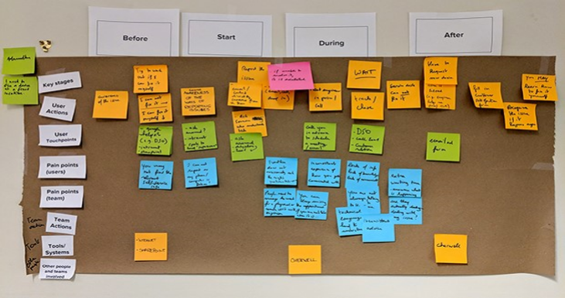
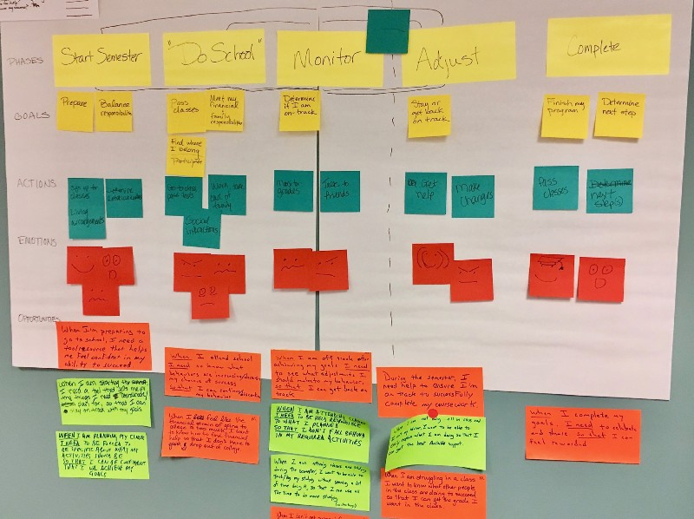
Examples
crisis.org.uk

Slide 17
Remember!
Take photos of the journey maps to write up after. It is much easier if people use proper permanent markers (e.g. sharpies) rather than biros so you can read the post-it notes from the photos
crisis.org.uk

