Slide 1
Prevention & relief toolkit
Discovery Report

Slide 2
Context

Slide 3
Background
Why the work is being done
Officers have been implementing the HRA for a year and a need has been identified for a guide/ toolkit to help with the assessment and development of personalised plans. This will provide guidance and prompts for officers to ensure consistency and support a common process to enable the development of better personalised plans. The toolkit could be structured around reason for approach, the sort of questions that should be asked during the assessment, suggested reasonable steps for inclusion in the plan and completed examples. This should not take away the creative role of officers but will provide a solid, consistent foundation to tailor things to individual clients accordingly. This guide/ toolkit would support and perhaps provide the interface for the current set-up in abritas and the directory of services that has been produced in sharepoint. Over time, the toolkit could help to identify gaps in the current provision or prevention and relief ‘offer’ available to officers.
Problem to be solved
How might we design a toolkit to support the development of better personalised plans and improve consistency amongst housing officers?
Who the users are and what they need to do
Users are any officers in the service involved in assessing customers and developing personalised plans as required by s.189A of the HRA
Any work that’s already been done

Slide 4




Approach & methodology: user-centred design and agile
Phases (iterative)
  Discovery
  Ideation
  Prototyping
  Implementation
Research to explore and better understand the problem. Build empathy and understanding of users, their needs and aspirations. Seek inspiration from others. Synthesise research into meaningful and actionable insights, identifying opportunities for design and improvement.
Brainstorm solutions to opportunities identified. Identify whether to re-use existing practice ideas or develop something new. Select most promising ideas and develop into concepts to take forward
Develop rough and working prototypes of selected concepts. Share and get feedback early to test hypotheses, assumptions, risks and key elements of the idea. Integrate feedback and keep iterating. Define a 'minimum viable solution' that meets key user needs
Develop roadmap for full solution. Continuous improvement after 'go live' - can include full pilots. Deliver more user needs identified in earlier phases and adapt to changing needs. Measure and monitor against KPIs
Description
Business case or benefits case
User research report (qualitative, ethnography)
Secondary research
User Journey and/ or Experience Maps
Service Blueprints
Insights & Design Opportunities
Tools/ Outputs
Show and tell
Brainstorming
Idea ranking
Storyboarding
Create a concept
Prototypes (low-res to high-res and live)
Minimum viable products/ solutions
Experience prototyping
Storyboarding
Feedback capture grids
Scenarios & Use Cases
Roadmap and KPI report
Implementation plan
Toolkit & outputs for others to adopt
Tested assumptions with real users and iterated designs accordingly before committing further resources
Identified biggest risks and reduced this
Identified what's most important
Product/ service that works for users and meets prioritised needs
Started measuring the performance
Shared understanding of problem
Frame design opportunities
Understand user types and needs
Understand user experience today
Identified solutions
Key concepts to take forward to next phase
Outcomes

Slide 5
Discovery plan
Discovery Goals
Confirm real nature of challenge around consistency and quality of personalised plans
Get detailed understanding of how officers do this at the moment. What are the current problems or frustrations? Are there different ways officers do things/ distinct types? What do they use at the moment?
Capture user needs and requirements for the toolkit, prioritised in a hierarchy
Understand good/ best practice in this area. Is there anything we can use/ learn from other authorities?
What we already know
Assumptions
What do we need to learn more about/ what don't we know

Slide 6
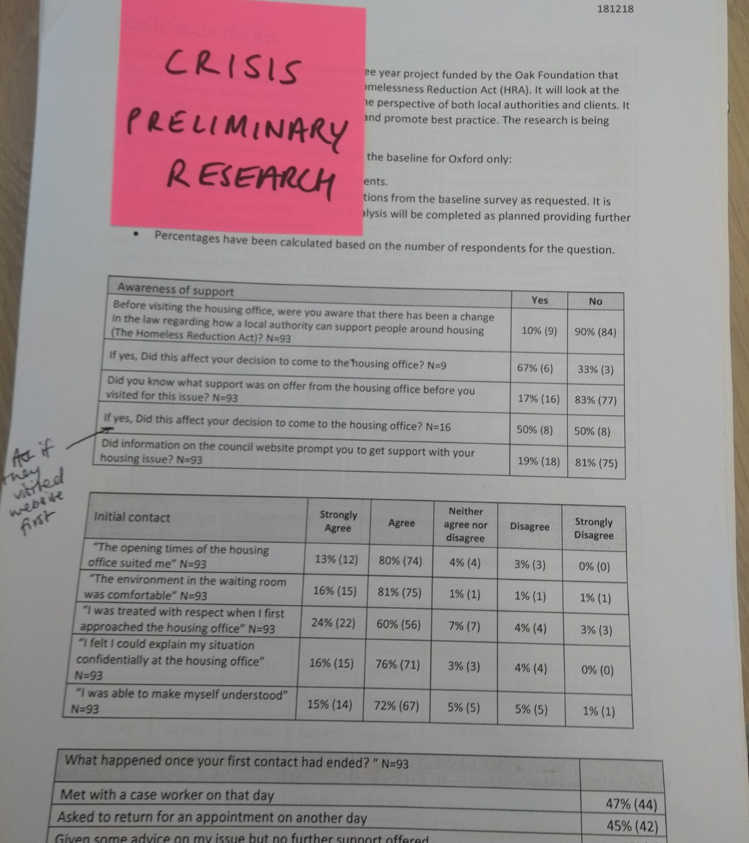
Our research
x workshops with officers involving group interviews and journey mapping
Sample review of PHPs - aim was to do a quick review to see if the outcome of the assessment and resultant actions are consistent across officers for similar cases
Conversations and observations with officers
Data analysis (file audit and task usage in <case management system>)
Desktop best practice research

Slide 7
Key insights
Notes:
Nature of challenge/ problem

Slide 8
Key insights from user research
Theme | Insight

Slide 9
Example practice from elsewhere
Partner involvement in PHPs – both collaborating, editing and owning development
Customer feedback and input into PHPs and their usefulness – responding and iterating as a result
Holistic assessments using tools like the Outcome Star
User-centred development of PHPs e.g. Lewisham whose template utilises a strength-based approach
Communicating standards/ expectations at front of PHP e.g. visualisation of the process, what the PHP is for, what clients can expect
Luton PHP workshops/ forums – excellent customer feedback, education workshops for those TWH to dispel myths, build positive relationships, explain the process, improve client confidence with interactive discussion. 76% attendance
Motivational interviewing skills and training
Pre-interview packs and information provided to customers
Different PHP templates based around reason for approach - Southwark have 12, Milton Keynes have 20 (worked closely with staff to develop)

Slide 10
Data on quality and consistency of PHPs
<If case file audit has been completed, include results here>

Slide 11
User groups
Who we are designing for
Notes:
- Personas (goals, frustrations, behaviours and habits)/empathy maps and user journey maps that help showcase the needs of users and visualise their current processes. generalized profiles that outline the archetypes of your common users

Slide 12
HAL officer
Housing officer
Team leader
Duty officer
FIP/WR/BETA/MAPPA Officer
Initial user groups identified
Notes:
Who are our users?

Slide 13
User groupings from research
User personas are generalised profiles that outline typical/ common users and their goals, frustrations, behaviours and habits. They help showcase the needs of users and visualise their current processes. Persona spectrums focus our attention on a range of user motivations, contexts and abilities so we avoid the biases and assumptions built into a persona. Our user research showed we need to think about and design any toolkit/ solutions around the following spectrums:
Staff experience in the role
Staff confidence (specifically around probing and identifying support needs with difficult or challenging clients)
Extent of "handholding" with clients
Staff attitude ("client not me") and framing of the process
Stage in the customer's journey
Context of interview (F2F or phone) and internet/printer access
Approach to the assessment and priorities (holistic vs. housing)
Notes:
persona spectrums focus our attention on a range of customer motivations, contexts, abilities, and circumstances. By designing along a spectrum of need and motivation, we avoid the biases and assumptions built into a persona. physical, social, economic, temporal, cultural contexts
Physical context
Situational context

Slide 14
User Needs
(At each stage of the PHP process)
Notes:
Prioritised list of needs. Is something meeting them now?
Most important > evidenced > focus on problem > high level and non-changing
‘User needs’ are the needs that officers have of the PHP and assessment process, and what the process must satisfy for the officer to get the right outcome. Need a good understanding of these - purpose of the user research A toolkit designed around users and their needs: is more likely to be used help more officers get the right outcome for them

Slide 15
User needs from research
‘User needs’ are the needs that officers have of the PHP and assessment process, and what the process must satisfy for the officer to get the right outcome. One of the purposes of the user research was to build a good understanding of these and see if they are currently met or unmet by other things. A toolkit designed around users and their needs is more likely to be used and will help more officers get the right outcome. Below is a summary of the seventeen most important high-level needs.
Before the assessment interview
During assessment interview
After the assessment interview
Goal: Resolve presenting issue promptly if possible
Goal: Develop a tailored and personalised plan which, if followed, will sustainably prevent/ relieve client's homelessness
Goal: Communicate outcome (as per law) and start identified actions
Have the information to make the appropriate enquiries and referrals
Quickly access suitable accommodation
7. Have the right information and evidence
8. Have a full housing history to properly assess housing needs
9. Identify support needs and where these are currently unmet
10. Make sure client actions are realistic, follow from the assessment findings and are meaningful
11. Have access to appropriate prevention and relief tools with knowledge of when/ how to use them
15. Easily capture outputs of the assessment interview
16. Clearly and simply communicate next steps in a user-friendly format
17. Establish and agree timescales to review the plan and actions
Goal: Suitably prepare for assessment interview
As a Team Leader
I need to monitor the consistency and quality of officer assessments and personalised plans
So that I know we are delivering a high quality service to our clients
As a Team Leader
I need officers to complete all required fields correctly on their case files
So that we meet the validation requirements when submitting our statutory returns
Goal: Motivate client to follow the plan and make sure they understand the process/roles
3. Have validated information to confirm eligibility and duty owed with supporting reasons
4. Have an initial understanding of why they have approached, their history and any housing or support needs
5. Be aware of any risk factors
6. Schedule interview at a suitable time and location for me and the client
12. Increase client motivation and build commitment to change
13. Manage challenging client behaviours and situations, with support when I need it
14. Clearly communicate client rights, the process and what they can expect

Slide 16
Scoping solutions and toolkit
Notes:
User stories/ requirements linked to needs
Features of an MVP – just enough features to test with users to check it works
Ideate some concepts/ future journeys/ improvements - Concepts (features/ advantages/ benefits)/ success factors

Slide 17
Suggested approach
Following the findings of the research it is suggested the two immediate priorities should be generating buy-in to the PHP process, reiterating its purpose, and building officer take-up of supporting tools that have already been developed
1
Generating buy-in and reiterating purpose of the PHP
2
Increasing take-up of existing supporting tools
3
Developing a prevention & relief toolkit
See next slide

Slide 18
Scope of the toolkit
A list of potential features for the toolkit are documented below, linked to the user needs identified in the research
EXAMPLE
1
2
Minimum Viable Product (MVP)
Just enough features to test with users to check it works
Potential additional features
8. Have a full housing history to properly assess housing needs
Housing suitability checklist/tool
9. Identify support needs and where these are currently unmet
Holistic assessment tool e.g. outcome star
Diagram for customers
12. Increase client motivation and build commitment to change
Tools from the Crisis motivational interviewing training e.g. crib-sheet and practice observation checklist
Referrals and accommodation information – linked to suitability. Live information on accommodation spaces?
Outcome measurement
Standards/ diagram for customers?
Reasonable steps by excluder group
Accommodation officer – e.g. hostels, accredited providers
Standards (light hearted) for what we want to see – provide structure and consistency
Mediation training
Flowchart with prompts for different scenarios – what do I do if . . .
Up-to-date info on services, what services are available
HAL - criteria for referrals e.g. hostels
What to do with difficult cases, what is suitable e.g. if no tenancy skills?
Prevention tools
PHP prep sheet/check list before assessments

Slide 19
Business Outcomes

Slide 20
Measuring success and progress
Success of the toolkit and other interventions will be determined by an increase in the quality and consistency of assessments and personalised housing plans.
The first of two primary sources will be the ongoing case file audits – for our purposes the score for the "accurate and appropriate advice and PHP" element of the process which takes into account the following:
Appropriate options
Signposting/referrals
Tailored PHP actions
Provision of PHP with accompnaying letter
Any solutions as part of this work will look to both improve the aggregate score across the service but also reduce differences between officers.
The second source will be customer feedback once established, in particular looking at:
Experence of the assessment and PHP process (were they listened to, felt understood, aware of what was available and why)
Did they leave feeling positive about their options?
Were they aware of their PHP? Did they feel it was personalised to their needs?
Did they find the PHP useful?
Additional measures of success include a reduction in ombudsman complaints, relevant requests for review (e.g. around suitability) and staff feedback.

Slide 21
Plan & next steps
Notes:
Product roadmap

Slide 22
Delivery Plan
This plan represents our intentions, not a commitment. It will be regularly updated and changed. High-level objectives and delivery dates are shown for 3-month project increments
EXAMPLE
2019 |  |  |  |  |  | 2020
Jul | Aug | Sep | Oct | Nov | Dec | Jan | Feb | Mar
Reiterate purpose of the PHPs and value to officers and customers
Structure and clarity around PHPs
Set up customer feedback
Use customer feedback
Improving the PHP and assessment process for officers; which will lead to more consistent and better quality plans for our customers
Make best use of existing supporting tools to help officers
Framework for performance and support
Awareness and use of existing tools
Develop and enhance existing tools
Develop a prevention & relief toolkit to support officers
Develop toolkit MVP (for new starters)
Toolkit iteration (TBC)
Toolkit iteration (TBC)
Notes:
Schedule of timeboxes (2-4 weeks). Who/What/When. Demonstrable outcome/objectives/deliverables - "backlog"
Delivery plan. 6 weeks
High objectives and delivery dates for future increments
Long term vision: ultimately achieve for users. value of project. Project increments (with clear objectives/goal). Measure progress.
This roadmap represents our intentions, not a commitment. It will be regularly updated and changed.
Firebreaks

Slide 23
Work Plan (July 2019)
Work Item | Description | Deliverables | Lead Resource
Structure and clarity around PHPs
Interview Script | A short script for officers to refer to and use at the start of each assessment interview. Will communicate client rights, the process and what they can expect | Draft script
Case Review Sessions | Incorporate role and quality of PHPs into new case review sessions. Interactive discussions to clarify purpose with practical examples | Case review sessions started PHPs/assessments incorporated
Set up customer feedback
Customer Survey | Draft and review survey to start collecting customer feedback | Draft survey Draft approach
Framework for performance and support
Competency Framework | Include staff confidence and performance with assessments/PHP in competency framework (in development). Could include self-assessment element | Proposal for how to include within competency framework
Peer shadowing and support | Discuss with staff at next peer support groups how they want to utilise peer support to improve PHP consistency and quality. One idea we had was peer shadowing & feedback | Discussion at peer support session Officer ideas to take forward
Awareness and use of existing tools
Interactive List | Provide interactive list of current tools available with embedded links and brief description | Draft list
Supporting activity
Baseline to measure progress | Use case file audit to provide a baseline to measure progress against and success of this project | First round of case file audits complete
Validate user needs | Review the user needs drafted with officers to validate and amend as necessary | Validated user needs
Project resource/ capacity (July)
Name | Days
EXAMPLE
Notes:
Schedule of timeboxes (2-4 weeks). Who (resources)/What/When. Demonstrable outcome/objectives/deliverables - "backlog"
Measure progress – completion of products or other deliverables
Initial MosCoW prioritisation – requirements
Objectives/ Requirements/ Deliverables/ Tasks
Work Item – Priority – Description – Acceptance Criteria – Lead Resource

