Slide 1
Reducing the number of people ‘falling out’ of the Housing Wales Act
Project Summary
April 2021 – March 2022
Contacts:
lisa.naylor@crisis.org.uk
marcia.williams@crisis.org.uk
www.crisis.org.uk/consultancyservice
Notes:
What does a good case file look like?
Unmet training needs
If there are certain areas that we don’t agree on or raise particular concern, we (I) can audit further cases to look at these specific things
Areas that are picked/selected for improvement should then be done together with the team and coordinated by myself (most likely) so that there is real ownership and input from the front line staff
Appendix – Scoring methodology

Slide 2
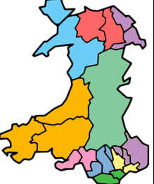
Content:
Introduction to the project and summary of findings
Underlying drivers of fallout rates in each local authority
area
3. Quick wins and design opportunities
4. Concept and prototype plans
5. Action plans
6. Evaluation methods
7. National policy implications
8. Tools and templates
Ceredigion
RCT
Caerphilly

Slide 3
Introduction
Crisis, funded by Oak Foundation, have worked with three Welsh local authorities to consider how services could be redesigned to reduce the number of customers “falling out” of the statutory housing system within S66 and S73.
Previous research has highlighted the high number of customers affected by this, but further work was required to develop and test service changes, tailored to local context, that might improve outcomes.
The project was devised and commissioned pre-covid and the fall-out considered has spanned pre and post covid. During this time, the Welsh Government's response to provide everyone in need with accommodation was actioned and more changes are likely to occur in the homelessness system in the coming months.
All three housing options services worked with Crisis to complete a holistic service review led by project teams from within the service, coming together to give their views and ideas. These then formed the basis of the discovery phase of the project where further information to support the views and ideas of the team were uncovered.
The results of the discovery phase, development of potential solutions and actions taken are documented in this review.

Slide 4
"Fall out" categories
Withdrawn application - The applicant has withdrawn their application, or the applicant has requested/stated they no longer require assistance from the Authority following the outcome of the Section 62 assessment ('Duty to assess'). Withdrawn application due to loss of contact - Should only be considered for closure if there has been no contact with the application for more than 6 weeks. Need evidence of attempts to maintain dialogue. Failure to cooperate - Local Authorities should not invoke until they have made every effort to obtain the co-operation of the applicant and explained the consequences of not doing so. Must be satisfied that the applicant is not failing to co-operate because they are vulnerable, have an unmet support need or have difficulty communicating, perhaps as a result of ASD. Must explain their reasons to the applicant and give them reasonable opportunity to reengage with the process e.g. has there been a 'minded to' letter. Assistance refused - Cases where applicants refused an offer of accommodation. Applicants must be allowed a reasonable period to make a decision about accommodation. Was the offer suitable? Was the applicant given sufficient time, given their personal circumstances? Other – any situation not covered by the above categories.

Slide 5
Summary of key reasons for fall-out identified by the project work:
  Accommodation did not always meet needs – some temporary accommodation had particularly high fall-out rates - little evidence of suitability checks even when clear evidence of customer circumstances on files eg. Health, family connections, schools etc. Lack of suitable move-on accommodation identified in all areas causing lengthy stays in sometimes unsuitable temporary or supported accommodation.
  Limited time to conduct quality casework links to fall-out identified (small sample studied) - a large proportion of past fall-outs showed poor scores across casework in an audit. No evidence of casework standards to adhere to. Likely high caseload implications.
  Reasonable steps by Council lacking in casework – few or generic steps identified could contribute to potential breakdown in relationship between customer and council together with use of "support worker" model leading to council having little direct contact with customer.
  Progressing customers along the homelessness journey effectively could be improved – much better engagement and progression seen in initial phases of the process. Some cases showed little or no contact following assessment to close of file with little evidence of a selection of contact methods being used.
  Letters and communications with customers were lengthy and confusing. In some cases, communications with partners organisations could be strengthened to provide a stronger "safety net" for customers.

Slide 6
Local drivers of fallout rates and common themes

Slide 7

63% of LSOAs in the top 50%
High levels of complexity
High level of prison leavers
Lack of stock for permanent housing
High demand and rising levels of assessments
Size 278 square kms
Population 180,000
High level of singles at S73
S66 Success
73% (high)
S73 success
22% (low)
S66 fall-out
18% (19/20)
S73 fall-out
25% (19/20)

Slide 8

S66 success
71% (high)
S73 success
56% (high)
S66 fallout
16% (19/20)
S73 fallout
24% (19/20)
71% of LSOAs in the top 50%
Increasing levels of complexity
High level of prison leavers
Lack of stock for permanent housing
High demand service
Size 424 square kms
Population 242,000
10% rise in need for supported accommodation in 19/20

Slide 9

46% of LSOAs in the top 50%
Tourist/university market for housing
Seasonal homelessness
Workloads high and increasing
Size 1795square kms
Population 73,000
Lack of stock causing backlog in system
Affordability a big issue
S66 success
58% (high)
S73 success
47% (high)
S66 fall-out
27% (19/20)
S73 fall-out
23% (19/20)

Slide 10
During the discovery phase a number of themes were identified which could influence fall out rates
Communication​
with customers​
Complex needs/
repeat customers​
Technology​
Customers don't always have suitable tech
Internal systems need upgrading or functionality improved
Technology not joined up
Lack of time to practice PIE and TIC approaches
Continuity of officer throughout process
Lack of clear up to date comms for customers and partners
Dislike of temporary accommodation
Housing First needs expanding or starting
Lack of appropriate support whilst in the system
Example insights

Slide 11
During the discovery phase a number of themes were identified which could influence fall out rates
Current processes/ partnerships​
Customer feedback/insights ​
Accommodation options​
Support worker model blocks relationship with customer
Improve links with health and care services
No consistent way to track customers housed by other means
Travel is expensive so mix of f2f and online preferred
Customer expectations don’t match reality
Need for more debt support identified
Too little turnover to meet demand
Customers spending too long in temporary accommodation
Finding support to meet customer need can be difficult
Example areas:

Slide 12
Quick wins and design opportunities

Slide 13
Make letters and PHPs more customer friendly
Improve casework standards and customer contact eg. staff training
Improve awareness of financial support available
Update procedure on ending duty categories to provide more consistency
Introduce a suitability template for TA
Reinvigorate attendance at local partnership forums
Updating of preferred contact methods
Understanding what resources are available, locally commissioned and non-commissioned
Reintroduce regular team meetings to enable information sharing and support staff wellbeing
QUICK WINS were identified by the project teams (defined as Things we can do in 8 weeks with some effort, design and consultation)

Slide 14
Link to project aims/other initiatives
More detailed DESIGN OPPORTUNITIES were identified before being further developed into concepts and prototypes
How might we proactively prevent homelessness?
Less customers in the system means more time for caseworkers to effectively work on cases, reducing fall out and putting less stress on the system in general.
How might we increase proactive engagement between client and caseworker?
Promoting a strong, positive and trusting relationship between caseworker and customer will help to build a strong conduit for information sharing and help to stop customers leaving the system with a fall out outcome.
How might we provide continuity and clarify of support for customers?
Providing a service that increases positive, informative contact in a range of different ways will build trust, positive relationships and helps to reduce the number of people leaving the system with a "fall out" outcome.
How might we use our TA as a platform for positive, sustainable outcomes?
Improving our provision of TA and supported housing provision will give customers more choice and assist in positive outcomes and promote a culture of sustainability.
How might we improve access and availability of PRS?
Improving access to PRS and strengthening existing links will help to provide more move on accommodation, allowing more customer choice and helping to move people through the system more quickly, helping to reduce numbers who leave the system early through fall out.
Key:
HSG needs assessment
RRTPs
High Level Action Plan
Ombudsman's Report
Housing Support Programme strategy
Tyfu Tai – experience of people's experiences of working in local government and LAs
PSL leasing scheme
Code of Guidance

Slide 15
Link to project aims
More detailed DESIGN OPPORTUNITIES were identified before being broken down into concepts and prototypes
How might we improve casework and raise standards?
How might we achieve better outcomes for over 25s?
How might we reduce barriers to TA sustainment?
Maximising the use of all local resources to support vulnerable customers will help to meet customer need and prevent fall out.
How might we improve access to mental health, substance support and social care services?
Standardising service charge, former tenancy arrears and enforcement policies will reduce fall out and create a culture of sustainability.
Improving the provision of TA and supported housing for over 25s including HF units will give more choice and assist in positive outcomes and promote a culture of sustainability.
Incorrect data makes the effectiveness of any evaluation of the reasons for fall out and measure taken to combat this less effective.
Improves customer relationship with caseworker, improves customer experience, makes the patterns of fall-out more identifiable and enables service to be build around customer need.
How might we improve data quality around fallout rates?
Key:
HSG needs assessment
RRTPs
High Level Action Plan
Ombudsman's Report
Housing Support Programme strategy
Tyfu Tai – experience of people's experiences of working in local government and LAs
PSL leasing scheme
Code of Guidance

Slide 16
Concepts and Prototypes

Slide 17
From a large number of concepts, the following were prioritised to develop and test with prototypes
Caerphilly
RCT
Ceredigion
Carry out full needs assessments with customers in TA and at an early stage
Landlord insurances / guarantor schemes / Rental guarantees
To scope out all the internal and external landlord offers/ packages of support
Monitor, evaluate and review prevention activities, and any unrecorded activities
Review pathway to increase client engagement
Consider PIE approaches when reviewing/revising pathways
Consider "models of support" from other local authoriteis
Review officer specialisms - one officer all the way through?
Review officer caseloads
Reinvigorate partnership working and meetings - definitely health and care
Debt worker in house? Reviewing CAB work

Slide 18
Example "Concept Capture" Sheet
What is the name of your concept?
How might we . . .provide continuity and clarity of support for customers?
How does your concept work?
Consider existing partnership working arrangements and identify where there are gaps in existing provision either in terms of collaboration opportunities, joint working or information sharing.
Consider reinstating CELL meetings
Consider the effectiveness of existing meetings already taking place
Pay particular attention to our relationship with health and care and seek opportunities to work alongside each other and collaborate when dealing with the same customers
Who is the target user or users?
Partners of the homelessness service but particular health and social care colleagues and first and second line health services eg. GPs and hospitals.
Are there any anticipated barriers/challenges to your concept?
Partner buy-in
Officer buy-in
Time to undertake more engagement with partners
Aligned vision and values
Place post-it drawing here
What value does it bring? How does it address the design challenge?
Strengthening existing relationships and working towards a service that can offer a multi-agency approach to the management of homelessness throughout Caerphilly.
What are the key factors for success?
A desire from other services both within the LA and outside to engage with the multi-agency approach and to take responsibility for their part in ending homelessness.
Providing opportunities to partners that are suitable and effective.
Describe your concept
Reinvigorate partnership working and meetings – definitely with health and care.
Notes:
HMW Question

Slide 19
Example "Prototyping Plan"
What is the concept we are testing? Design Opportunity 2 - How might we provide continuity and clarity of support for customer?
Reinvigorate partnership working and meetings – definitely with health and care
What assumptions do we need to test?
1. There is an appetite for more partnership working from our partners.
2. That we already have some strong relationships that just need revisiting
3.Working more closely with partners would bring extra benefits across all our work.
4. Health and care are particularly useful partners in relation to falling out work.
What key questions do we have about how the concept should work? Are there specific components we want to look at?
1. Can we piggy-back on existing partnership meetings or opportunities?
2. How often should any meetings with partners be?
3. Should we have an all partners meeting or specific meetings with different partners from different sectors/areas?
4.What other types of interaction do we need to think about that will bring relationship benefits?
How will we prototype key questions & assumptions? How will we capture feedback?
1. Telephone/email partners to scope out appetite for meetings and working more closely
2. Survey of partners to rank our relationship and the need for meetings/working more closely. Also offer options with regard to frequency of meetings, participants and reach.
3. Target our partners in health and care services to find out where opportunities to work more closely are being missed.
4. Check out what events/meetings are already on the timetable we could piggyback onto.
5.Research good partnership working principles.
<If role play> What scenarios will we use? What are the roles required and who will play them?
What do we need (activities, resources, people etc.) to implement the concept and turn it into a reality?
1.Staff time to prepare survey, ring or email partners, research existing meetings and partnership working principles.
2.Potential venues – If not online – for meetings to happen.
3. Staff time to evaluate results and feed back to management.
Notes:
What Is the Most Important Question to Answer? How might we answer it?

Slide 20
Action Plans

Slide 21
Action Plans
Three separate action plans were drawn up.
The main purpose was to:-
log and follow the progress of all the ideas generated through their testing phases to completion.
provide a place to store the backlog of ideas, concepts and prototypes, as yet untested for the future.
provide an area to store pre-existing ideas and service changes
Three elements of the action plans:
Quick wins: A log of the quick win ideas, owners and reasons for development
Concepts and prototypes: a space for keeping the developed concept ideas and any prototypes, created from the design opportunity ideas, showing what is needed to test each concept prior to full implementation/ "go live" in service
A roadmap: A space for actively planning and managing the implementation of the above, dependent on service capacity

Slide 22
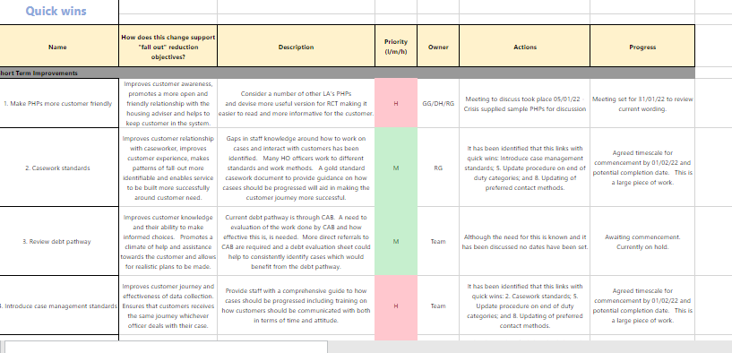
Action Plan: Quick Wins

Slide 23
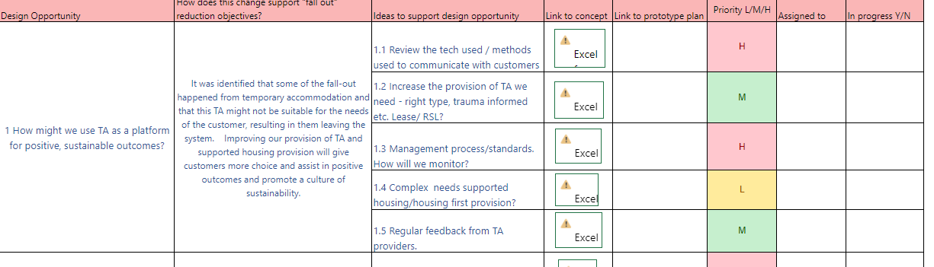
Action Plan : Design Opportunities > Concepts > Prototypes > Implemented

Slide 24
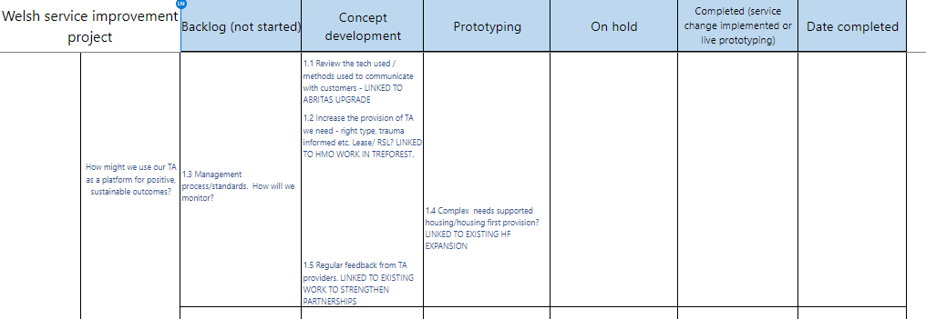
Sample roadmap

Slide 25
Evaluation and monitoring

Slide 26
Evaluation will take place from the end of the project for a period of 12-18 months
Regular check-ins will be organised with all three local authorities on a 3 monthly basis to check progress against action plans
Surveys will also be sent out on a three-monthly basis, to track staff's observations on the changes being made
A mid-way staff event will be organised to discuss progress and provide some qualitative feedback

Slide 27
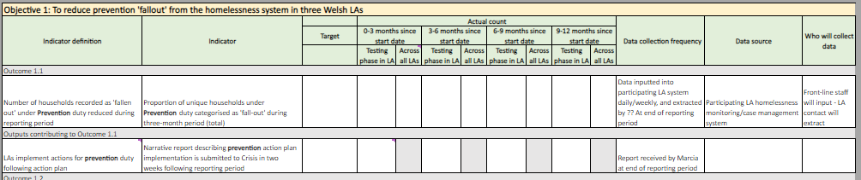
A results trackers has been devised to record impacts throughout the 12-18 month period.
Sample of Objective 1.1 below

Slide 28
National Policy implications

Slide 29
Comparative findings to the Ombudsman's report
Letters and PHPs too generic, not personalised enough, too technical and difficult to understand.
Guidance around classification of case closure outcomes not clear
No system in place to inform officers how frequently they should contact customers during casework or when closing files – casework standards
Could have wider range and improve use of tech to communicate with customers – more streamlined customer contact journey
Lack of simple, straightforward information available for customers and partners – websites out of date – could increase and improve self-help opportunities

Slide 30
Policy implications of work
Inconsistencies in data recording – importance of data collection to provide true reflections, inform future planning and commissioning.
Lack of suitable and affordable move on – size, location etc.
Data digital and tech – GDPR, data sharing use of technology to contact customers and improve communication
Frustrations regarding lack of availability / ability to provide TA that is suitable for customer needs

