Slide 1
Using this toolkit
This toolkit is to help you to facilitate conversations about homelessness. It forms part of the resources available to you which includes
This toolkit
10 key messages
FAQ’s
Toolkit for engaging with different audiences
You do not need to use all the slides, but can build a presentation that fits with the timings and audiences that you are presenting to
You may choose not to use slides, and this is completely within your power
Youtube links for videos you may choose to use in your talk are in slide notes. Feel free to embed these into your own version of the PowerPoint.
Slides we recommend you use:
9&10 – types of homelessness
13&15 – causes and impact of homelessness
21&22 – helping someone who is sleeping rough
23&24 – changing the way we talk about homelessness

Slide 2
Understanding homelessness and how you can be part of the solution
Notes:
Introduce yourself and that you are a Crisis Community Advocate. Explain that your role is to talk to them about homelessness on behalf of Crisis and help them understand how they can be part of the solution in ending homelessness.

Slide 3
What does Crisis do?

Slide 4
What does Crisis do?
Crisis delivers services - working directly with people at risk of or experiencing homelessness, providing practical one-to-one support to help people access benefits, healthcare services, employment opportunities, and more.
Crisis takes a housing led approach - all of us need a decent home to be healthy and to thrive. That’s why one of Crisis’s main goals when working with people experiencing homelessness is for them to find safe and affordable homes as quickly as possible.
Crisis undertakes research - Crisis cutting edge research helps us all to better understand the scale, causes, impacts of homelessness and solutions to prevent and end homelessness.
Crisis campaigns – for the policy and practice changes to prevent and end homelessness. With collective action and political will, we know we can end homelessness for good. Crisis’s campaign work is shaped from direct work with people experiencing homelessness and helps tackle the societal pressures that push people to the brink.
Crisis collaborates – collaborating with partners means that homelessness becomes everybody’s business and by working together we can support each other's roles in preventing and ending homelessness.
Notes:
Crisis delivers services on the frontline in 9 areas of the UK:
Edinburgh
South Wales
London
Newcastle
Birmingham
Merseyside
Oxford
Brent
Croydon
Between 6,000 and 8,000 people access our Skylight services each year. Each individual is assessed and receives a tailored plan of support to meet their needs and help them to end their homelessness.
When campaigning on policy and practice Crisis is UK wide and have specialist colleagues in Scotland and Wales familiar with their policy and procedures. You can find out more by visiting the Crisis website.

Slide 5
Crisis 10-year strategy for ending homelessness
Crisis goals
Crisis vision
Securing policies that solve homelessness
In ten years, the number of people who are homeless will be going down. This doesn’t mean no one will ever lose their home again. But there will be better ways to prevent it – and quick housing-led solutions when it happens.
Deliver services that end homelessness for people and places
Building a community of people across Britain that are helping to end homelessness
Notes:
Securing policies that solve homelessness
We can end homelessness – we just need the right policies and social change. We’re already working hard to make this happen. But there’s still a way to go. So, we’ll carry on campaigning in England, Scotland, and
Wales to get the policy changes we need. We’ll also challenge damaging beliefs about homelessness. These create stigma and hold back political progress.
Deliver services that end homelessness for people and places
We’ll build a network of Crisis Centres across the country and for the first time directly deliver good quality, affordable homes for members. This will deliver breakthrough systems change in our communities. We’ll do this in partnership with people facing homelessness, volunteers and local organisations. In the areas we work in we will see homelessness levels come down. Finally, we’ll build on Crisis at Christmas, expanding services outside London and provide more help to people rough sleeping.
Building a community of people across Britain that are helping to end homelessness
We’ll work with anyone who can help end homelessness. That could be landlords, local authorities, or employers. Or individuals who want to make a difference. We’ll help communities up and down the country play their part in ending homelessness. We’ll build a coalition of people who are willing to use their skills, energy and power to make a difference.
You may wish to play a Crisis video here. One we recommend is https://youtu.be/n0sa8-dXHUQ. This Youtube link can be shared with your audience.

Slide 6
What is homelessness?

Slide 7
What does home mean to you?
Notes:
Depending on how you are delivering this you could deliver this question in a number of ways:
Virtually – use slido or a Teams online tool to create a word cloud, ask people, to pop words in chat
In person - use post it notes, post them on a flipchart with a drawing of a house on.
Pick out some of the key points and ask people to consider how they would feel if they didn’t have the things that home means to them. Keywords that often come up are stability, security, safety, warmth, family, pets, somewhere to come home to after work

Slide 8
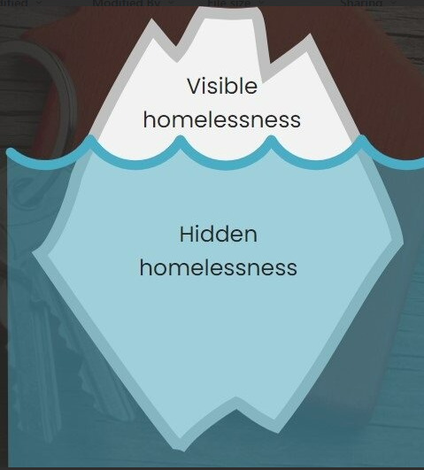
Homelessness is the lack of safe, secure accommodation - the lack of a home​
We all need a decent, safe and genuinely affordable home – to live our lives well and to thrive
Notes:
Explain homelessness is not just about what we can see when we are moving around our towns and cities, but also what we cannot see. There are both visible and hidden forms of homelessness. Visible forms of homelessness make up less than 10% of core homelessness figures.
Facilitate discussion on what types of homelessness people know of:
In person – you could have a flipchart with the iceberg on and ask people to write the types of homelessness on.
Visible:
People sleeping rough
People sleeping on buses and trains
People sleeping in cars
People sleeping in tents
Hidden:
Squatting
Sofa surfing
People in refuges
Hostels
Non –residential buildings
Churches
Hotels and Bed & Breakfast’s
Overcrowded housing
Shelters
Temporary shared housing
Rural homelessness can be hidden – especially in places like woods
Groups more at risk of homelessness – LGBTQ+, minority communities, those leaving prison, the armed forces, the care system, experiencing domestic abuse, receiving benefits, refugees
Crisis works with anyone experiencing any of these forms of homelessness.

Slide 9
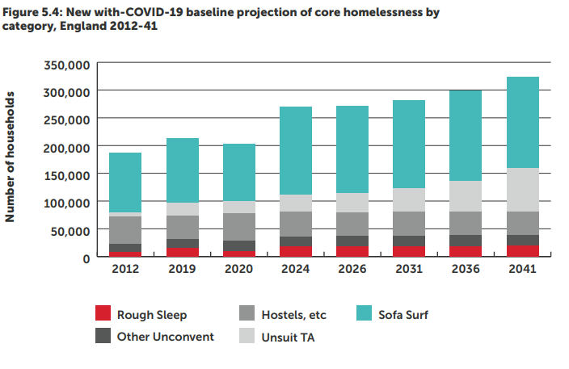
Homelessness is not just rough sleeping
Just as an illustration:
The table shows that sleeping rough is just the tip of the iceberg and that there are many other forms of homelessness.
Without action, the number of people experiencing all forms of homelessness is only going to increase.
The homelessness monitor: England 2022
Beth Watts, Glen Bramley, Hal Pawson, Gillian Young, Suzanne Fitzpatrick, & Lynne McMordie February 2022
Notes:
Explain this table illustrates the different forms of homelessness and that it is not just about rough sleeping.
Currently (2024) 242,000 families and individuals across England are experiencing the worst forms of homelessness. 88% of councils have reported an increase in requests for support from those evicted (Homelessness Monitor 2023). If action is not taken, these numbers will continue to increase and more people will be experiencing these forms of homelessness.

Slide 10
Causes and impact of homelessness

Slide 11
Would you rather?
Notes:
This activity can be done virtually or in person.
In person: for each question people have to make a choice and place themselves on one side of the room or the other. Pick on a couple of people to give their answers.
Virtually: You can either use polls, ask people to give a thumbs up or down for answers or type their answer in chat. If using polls ask if anyone wants to share their choice and rationale, if chat you can select or ask for volunteers.
The idea is to start with general questions and then build into the topic of homelessness. You can use the examples below or come up with your own!
Example questions:
Would you rather have the superpower of invisibility or be able to fly?
Would you rather win the lottery or live twice as long?
Would you rather never watch tv or never use social media?
Would you rather never have a pet or not have a bathroom in your home?
Would you rather have to be in by 8pm every night or only sleep for an hour each night?
Would you rather always have cold showers or never have a hot meal again?
Would you rather go without heat or food?
Would you rather have school shoes and uniform for your child or be able to pay your rent?
Would you rather not have enough money to pay for your home or not have enough money for food for you and your family?
Would you rather keep your dog that you have had for a number of years and stops you feeling lonely or give your dog up so you have somewhere safe to live?
Discussion points:
Some people struggle to pay their rents due to the cost increasing more than wages and benefits. This is one of the main reasons why people are being pushed into homelessness.
Over 250,000 households across Great Britain are currently in temporary accommodation – accommodation that is often unsuitable, sometimes dangerous. Imagine living in somewhere you cannot make into a home, possibly being miles from any friends or family or your child’s school, not having proper cooking facilities or secure spaces to store all your belongings.
People often may sleep during the day as this is safer when they are sleeping rough. In addition, imagine only having the belongings you can carry with you and having to carry these everywhere with you.
Ask how did they find choosing the answers to some of these questions? Were some easier than others? How does it make them feel about homelessness? Imagine having to make some of the4se tough choices all the time.

Slide 12
Causes of homelessness
Homelessness is caused by poverty, a lack of affordable housing and other social / political factors. These causes include:
Causes of homelessness
Mental and physical health
The cost-of -living crisis
Life events
Homelessness is not a choice. It is not about people making ‘bad choices’ or ‘bad luck’, but about the systems and wider context that shapes our lives that cause it.
Causes of homelessness
Notes:
Social pressures such as, poverty, systemic inequality, and incomes that are failing to keep up with rapidly rising rents – can put immense pressure on people. The cost-of-living crisis has piled impossible financial burdens onto people, and they can find themselves grappling with soaring living costs. It is rarely one single factor that pushes someone into homelessness, but a combination of life events and systemic factors.
Life events can also be a source of considerable pressure. This could be job loss, domestic abuse in the home, relationship breakdown, bereavement – or being evicted at a time when you cannot afford the money for a deposit or rent in advance.
Mental or physical health problems or substance use may add further strain for some people.
Think back to the last exercise – if you are constantly being forced to choose between those essential things all the time what impact do you think this will have on your physical and mental health and your relationships?
When this pressure builds - and is compounded by poverty and unaffordable housing - people can be pushed into homelessness.
The combination of soaring rents, the lack of supply of social housing and increase in the cost of living, is forcing more and more people into homelessness. Many councils are at breaking point and are struggling to find suitable accommodation. This means that across every country in Great Britain, the number of households in temporary accommodation has increased significantly.
Some of the main reasons that people present to a local authority homelessness team:​
Being asked to leave by family and friends ​
Relationship breakdown​
Domestic abuse​
End of private rented tenancy​
End of social housing tenancy​
Being discharged from a state institution – hospital, leaving care or prison

Slide 13
Put yourself in their shoes. How does homelessness impact on people?
Notes:
This activity can be done virtually or in person.
In person: Flipchart or multiple flipcharts for people to write answers on.
Virtually: You can use slido or Teams tools, chat or call out
Ask people to share their thoughts on the different ways homelessness impacts on someone’s life.
Alternatively, you can use the following slide to discuss through the points.

Slide 14
Impact of homelessness
Our society is stronger when we all have a safe, decent home.
Causes of homelessness
Mental and physical health
Jobs and finances
Relationships
Notes:
- Homelessness doesn’t just impact individuals, it affects us all because we are common members of an interconnected society. We know just how much we rely on each other to get by. There is a significant human cost to homelessness. Having a decent home is vital for good health and wellbeing. It makes it easier for people to succeed at work and in education, to maintain relationships with their family and friends and to contribute to their community. Making sure that everyone has a secure and affordable home benefits us all, creating a stronger society where everyone can play their part.
In terms of how it affects an individual:
Mental and Physical Health
We have already discussed the pressure of having to make those difficult choices and the impact that may have on our health. However, staying healthy when homelessness becomes much harder. Not only may you not have access to warmth, healthy foods and the things that keep you well, but having no fixed address makes it harder to register with a GP, dentist and health services. In addition, sleeping or living on the streets is dangerous – more than 1:3 people on the streets have been deliberately hit or kicked or experienced some other form of violence. Incidents that go unreported to the police. Crisis research has shown that people who are sleeping rough are far more likely to be victims of crime than perpetrators. Being homeless increases the risk of dying young which is simply unacceptable.
Homelessness can also be lonely and isolating – imagine not having friends/family/colleagues to talk to.
Relationships
Being homeless can impact on your relationships. Relationship breakdown may be the cause, or living on the streets or in temporary accommodation can push your relationship to breaking point. In addition, imagine if you are experiencing in work homelessness and don’t feel comfortable talking to your colleagues about it – you have to constantly turn down social activities due to cost, you worry about not looking or smelling clean, your tired. You may have to move away from family to secure temporary accommodation and then cannot afford the travel costs to see people. You may not be able to see your children or have them to stay affecting those relationships at an important point in yours and their life. Being homeless puts huge strain on all forms of relationship which can increase loneliness and isolation.
Jobs and finances
Having no fixed address makes it harder to be able to register with a bank. No bank account means no benefit payments or payments from a job. These days so many things are card only so how do you do anything? Applying for a job with no fixed address is also very difficult.
Having the right ID can be difficult too if you don’t have a fixed address.
Some people are in work whilst homeless, being homeless then impacts in terms of their energy levels, access to resources, being able to get to work.
Being homeless can make it harder to access the tech you need to live and stay connected in this day and age- when everything is online how do you do it with no wifi, no credit etc. If someone is sleeping rough their possessions can often be stolen making this even harder.
You may wish to play a Crisis video here – one we recommend is https://youtu.be/zsdr4ZyDlEc – you can share this link with your audience if you wish

Slide 15
Can homelessness be prevented?

Slide 16
Ensuring access to legal help to prevent an eviction or mortgage repossession
By increasing the supply of good quality affordable housing
Yes
Supporting people to maintain tenancies
Access to mediation services
Ensuring access to health services to prevent poor health causing homelessness
Providing access to financial and budgeting support
Notes:
Each solution is set to appear as you click
Homelessness can be prevented and this is the best solution. No-one should have to experience homelessness and there is a significant human cost.
To prevent homelessness:
The pressures on those at risk need to be reduced
There needs to be better measures in place for those leaving a state institution
People need to know where to access help so they access it before losing their home
We need to spot the signs earlier to provide support.
As a society we need to:
Increase the supply of good quality affordable housing
Ensure access is available to legal help to prevent an eviction or mortgage repossession
Support people to maintain tenancies
Provide access to financial and budgeting support
Ensure people can access health services to prevent poor health causing homelessness
Provide access to mediation services for issues such as family or neighbour disputes to see if they can be resolved
We need to push our governments for these things to be in place.
Local councils have a duty to help those who are homeless or at risk of homelessness – as a minimum they should help them to put a plan in to address their situation.
Solutions that are being found to work:
Housing First – - A Housing led approach to ending homelessness that offers stable and permanent housing to people facing homelessness without judgement or preconditions - Provides unconditional housing, rapid and effective as an intervention for people who may have multiple and complex needs. Case workers have small caseloads to work intensively with people, providing one to one support, enabling choice and control over the support that people receive, advocating and working with community partners to ensure that people are able to access appropriate support in the community. Such as, GPs, dentists, hospital appointments, substance support, mental health support etc.
Critical Time Interventions – CTI –is a time-limited practice that has been demonstrated to work for individuals during periods of transition. Especially when transitioning from a state institutions, such as prison, hospital, leaving care or the armed forces. CTI focusses on community integration and continuity of care by ensuring that people have created lasting ties to their community and support systems. Case workers have small caseloads, and the support provided is time-limited, has a phased approach with different stages and the support decreases in intensity before it is finally withdrawn.
Built for Zero – is what is called a ‘place based’ approach – working with organisations and systems that operate in a particular community. Built for Zero works with 3 basic principles – homelessness is solvable, you can’t solve a problem that you can’t see, and homelessness is a systems issue. Built for Zero uses real time data, which means that they know who is experiencing homelessness in the community at any one time, and then creates a collective responsibility for addressing an individual’s needs and communities work together to find a housing solution which meets that person's particular housing need. Communities working in this way agree to try new things quickly and responsively to try to end a person's homelessness.

Slide 17
How you can help someone who is sleeping rough
Notes:
Play video on small actions - https://www.youtube.com/watch?v=U__5Ff52P1I
PLEASE DO NOT SHARE THIS VIDEO – THIS HAS BEEN CREATED FOR YOU TO USE IN YOUR TALK AND IS NOT APPROVED FOR PUBLIC USE

Slide 18
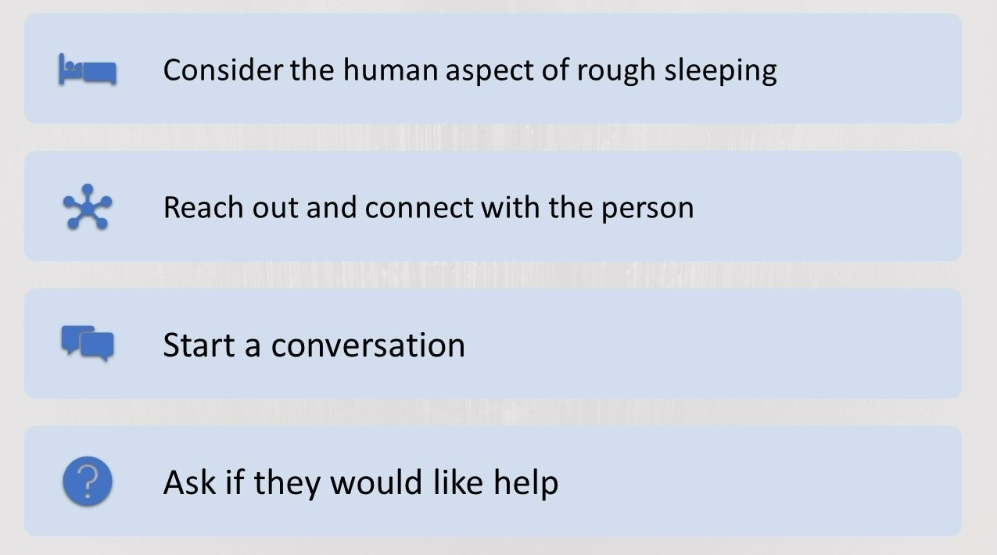
1. Remember we are all human.
Causes of homelessness
Notes:
Crisis members have told us that people stop seeing them as human when they are experiencing homelessness. They have also told us how important human connection is to them and that something as small as a conversation can make a real difference to their day.
Only approach someone if you are comfortable to do so but if you are here are tips on how to start a conversation:
​
Hi there, my name is [X], I just wanted to check if you are okay? ​
Are you happy to tell me your name? ​
I noticed you have been here for a while and I don’t think I’ve seen you around before, do you have anywhere to go? ​
Did you sleep here last night? ​
Would you like to tell me a bit about what’s happened? I might be able to direct you to where you can get help? ​
Have you spoken to anyone about what has happened, any support services, or the council? ​
I could get some contact for different agencies that might be able to help, would you like me to do that?
Check if they would like help – a psychologically informed approach means allowing them to be in control of their situation.
Giving money is an individual choice – if you are uncomfortable with this you could ask if there is anything they would like eg food, drink, vouchers, phone credit
Consider extremes of weather – for example in hot weather sunscreen, a cold drink, a sun hat would be really helpful. In cold weather, hot drinks and food and warm clothing

Slide 19
What to do if someone does want help
In England and Wales – send an alert through Streetlink
In Scotland – you can find information on Shelter Scotland
Refer to a Crisis Skylight Centre if you are in an area with one of these.
Refer to your local Councils Homelessness Team and local rough sleeping outreach teams
For Wales you can also visit the Welsh government website for information on services available.
Notes:
Call 999 in an emergency situation

Slide 20
2. Change the language we use to talk about homelessness
Help us to change the narrative on homelessness – we need society to see homelessness is not an individual choice but caused by societal and political factors. Use words/phrases such as
Causes of homelessness
They were pushed into homelessness
They had no option than to sleep
on the streets
Impossible financial burdens
Notes:
How we talk about homelessness has a real impact on the individual and our society – language is powerful. You can help by thinking about how you talk about homelessness to friends, family and colleagues – we need to frame the issue and build public support for change. We all know what it is like to be under pressure in life.
Discussion point - You could ask people what phrases have they heard that they feel contributes to the stigmatisation of homelessness? Examples could include – “They’re all on a scam”, “I look like a tramp today”, “Crackheads, druggies, they only have themselves to blame”, “She’s a rough sleeper – she chose that lifestyle”, “homelessness will always happen – it’s inevitable”, “we’re all just a pay check aware from being homeless aren’t we” – how do these phrases make you feel? Imagine hearing it said about yourself.
Then show suggested phrases to illustrate how we can change language and move away from an individually blaming culture
Use words that help to explain homelessness is caused by external factors, not bad choices. For example instead of saying she ended up rough sleeping – they were pushed into homelessness, they had no option.
Don’t say things like they lost everything – the word lost makes homelessness seem random.
Avoid words around choice eg they had an impossible choice to make as it makes it sound like homelessness is caused by bad choices.

Slide 21
Taking a person first approach so that we are not defining someone as different and only defined by their homelessness of homelessness
Person experiencing homelessness
Person who is rough sleeping
Person facing homelessness
Person with a problem with drugs
Notes:
When we use phrases such as homeless person and rough sleeper we are adding to the labelling of someone and ‘othering’ them. We are all defined by many things – we are friends, parents, colleagues, artists and homelessness should not be what defines a person. In addition, a person first approach suggests that things are not inevitable and can be overcome.

Slide 22
3. Educate people and change perceptions
Help people understand that homelessness is more than rough sleeping – tell them about the other forms of hidden homelessness
01
Explain about how society causes the external pressures that cause homelessness
02
Remind people we can end homelessness! And that this is about providing homes and fixing policies and systems, not fixing people
03
Notes:
It doesn’t need to be a big thing, just changing the way we talk and having open conversations can start to change the mindset of our society
We need people to believe we can end homelessness if we are going to make a change.

Slide 23
4. Support charities such as Crisis who are working to end homelessness
Causes of homelessness
Campaign
Donate
Educate
Fundraise
Volunteer
Notes:
Talking internally:
Promote Understanding Homelessness Learning and also the learning module on helping people experiencing homelessness which is written specifically for LBG
Signpost to LBG internal SharePoint pages for more info on how to get involved as part of the partnership
Signpost to Crisis webpages for more info on how to get involved outside of this
Campaign – sign up on the Crisis website to support our campaigns which lobby the government for changes in housing policy – as a collective we can have more impact, especially if government knows how many people this is an important subject to
Crisis has volunteering opportunities across its Skylight Centres, with its Changing Lives Programme and Head Office Teams, in its shops and within its fundraising teams. Crisis also needs help in raising awareness in communities on homelessness so sign up to be a Crisis Community Advocate. If there is no Skylight in the area, people could also make links with local homelessness charities and volunteer for them.
Fundraise/Donate – every penny raised goes towards ending homelessness. (Internal – also talk about payroll giving and signing up to LBG fundraising events and activities)
Educate – signpost to framing training on Crisis website.

Slide 24
Homelessness is not inevitable and we know that together we can end it.

