Slide 1
Let’s learn about ending homelessness.

Slide 2

What does home mean to you?
Notes:
You may:
Facilitate a call out
Ask them to draw pictures or
Use either of the activity sheets below
Young children (under 10)- Build a bug house activity​
Older children – what does home mean to you?
Follow up with the next slide and the discussion points
Purpose – to understand the key important elements of a home:​
Food​
Warmth​
Safety and security​
Somewhere to sleep​
Be with family​
Pets​
Somewhere to play, be creative, do homework, relax​
Somewhere to come back to after school​
Discussion point – Everyone should have a safe, decent home. This is more than the basics of somewhere dry to live, but includes feeling safe, secure, having support and being happy. Homelessness is not just people living on the street, but people who haven’t got a safe place they can call home and where they can keep their things and feel safe, for example sleeping on someone’s sofa, in a car or in a temporary home like a B&B or hotel.​

Slide 3


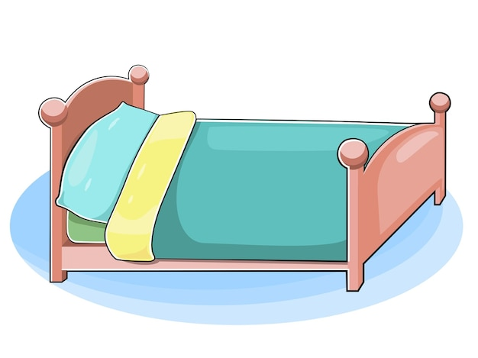
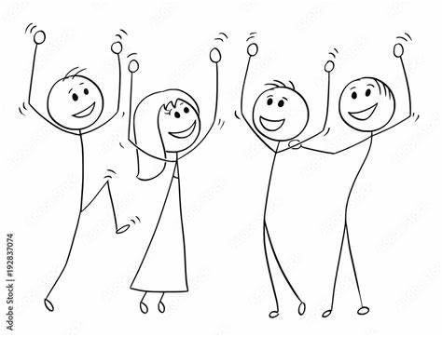


What does home mean to you?
Notes:
Purpose – to understand the key important elements of a home:​
Food​
Warmth​
Safety and security​
Somewhere to sleep​
Be with family​
Pets​
Somewhere to play, be creative, do homework, relax​
Somewhere to come back to after school​
Discussion point – Everyone should have a safe, decent home. This is more than the basics of somewhere dry to live, but includes feeling safe, secure, having support and being happy. Homelessness is not just people living on the street, but people who haven’t got a safe place they can call home and where they can keep their things and feel safe, for example sleeping on someone’s sofa, in a car or in a temporary home like a B&B or hotel.​

Slide 4
Homelessness
Homelessness is the lack of safe housing - the lack of a home.
People experiencing homelessness could be sleeping outdoors or on the streets, living in other types of buildings e.g. tents, cars, sheds or garages or other temporary accommodation.

Slide 5


Would you rather?
Option A – sit down
Option B – stand up
Notes:
Activity sheet – https://www.crisis.org.uk/media/242054/crisis_activity_would_you_rather_a5.pdf
For each scenario you make a choice – for option A stay seated and for option B stand up or move from one side of the room to the other. Examples are below but there are more options in the activity sheet.
Would you rather A. eat pizza every day or B. never eat pizza again?
Would you rather A. live without TV or B. live without music?
Would you rather A. never have a pet or B. not have a bathroom in your home?
Would you rather A. always have cold showers or B. never have a hot meal again?
Would you rather A. not have enough money to pay for your home or B. not have enough money for food?
These are nearly impossible choices that some people are forced to make every day.

Slide 6


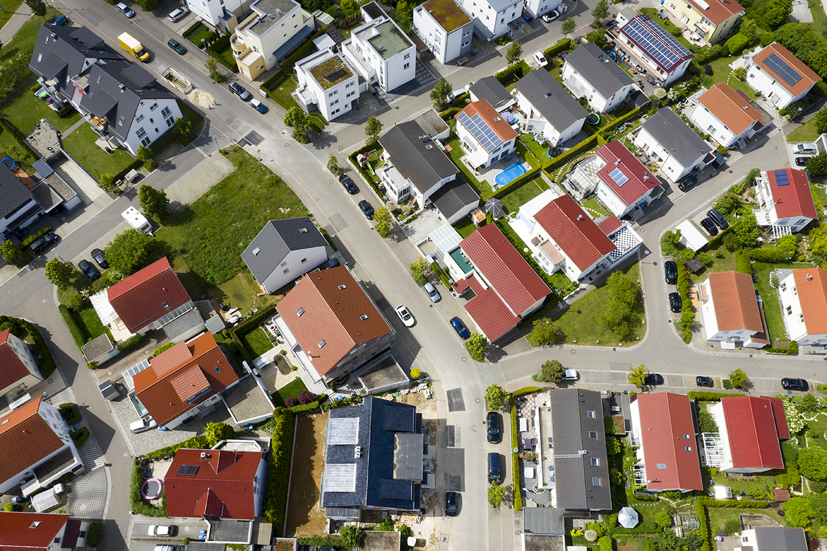


Why do people become homeless?
Job loss
Illness
Lack of affordable housing
Falling out with family
Increased costs
Notes:
Activities that can help facilitate conversation on why people become homeless?​
Activity - a safe bridge or In the net​
​
Purpose – to understand the reasons people become homeless and the impact of pressure​
​
Discussion point – people become homeless for many reasons. Ask the young people to call out if they can think of any of those reasons. ​
Reasons include​
People losing their job​
Illness​
Things costing more including the cost of home and bills increasing,​
Falling out with their family.
Lack of affordable housing ​
These things cause pressure on people, and this can push someone into homelessness. ​The rising costs in this country means that lots of people are having to make more difficult choices; to pay for food or lose their homes. Last year, the number of people experiencing homelessness in the UK increased.
​
​

Slide 7





How does being homeless affect people?
Notes:
Think back to when we talked about what home means to you. How would it feel to not have any of those things?
Be conscious there may be young people in the room experiencing homelessness, for example living in temporary accommodation.​
​
Examples include:​
Feeling sad and worried
Not having their own space, somewhere to keep their things​ and not feeling safe
Difficult to do homework/concentrate​/ be creative
Parents being stressed and arguing
Living away from family or friends​ and feeling lonely or isolated
Feeling lonely, isolated​
Being homeless can mean it is harder to find or keep a job, affects your mental or physical health including making it harder to access doctors, nurses and dentists, impact on relationships and leave you feeling isolated.​

Slide 8





What can you do to help someone who is homeless?
Learn more about homelessness​
Share what you have learnt with other people​
Be kind and caring​
Say hello
Buy them a drink/something to eat​
Do things to help homeless charities like Crisis such as fundraising
Notes:
Please start this discussion with being clear they should seek parental permission before engaging with someone who is homeless.
Be kind and caring and treat them as a person.
Say hello - often people who are sleeping rough feel invisible and ignored and just being treated like a human can make a difference​
With your parent’s permission – buy them a drink/something to eat/things they may need
Learn more about homelessness and share what you have learnt with other people
Do things to help homeless charities like Crisis – for example fundraising

Slide 9

What does Crisis do?
Notes:
You may want to play the video or explain: https://youtu.be/n0sa8-dXHUQ. Click on the title to open the Youtube video (or you may choose to embed it into your slide from your side)
Crisis is the national charity for homeless people. Crisis helps people by helping with:
Finding a job
Finding a home
Helping access health services
At Christmas providing food, support, a friendly face
Crisis also talks to important people in government to try and get the changes made needed to end homelessness.

Slide 10
We should all have a safe place to call home. Together we can make this happen.

